Slide 1
SCRO GBM #12
Welcome new and returning members
Yield Fundamentals
Aly Garcia
Special thanks to our sponsor:

Slide 2
Lecture 8: Yield Fundamentals

Slide 3
Recall:
So far we have covered:
Device physics (Lecture 1)
Semiconductor logic (Lecture 2)
Quick overview of semiconductor fabrication (Lecture 3)
Memory (Lecture 4)
In Depth Semiconductor Fabrication Process (Lecture 5&6)
Electrical Testing (Lecture 7)
Learning outcomes:
Understand what yield is and the basics
Understand how money $$ is involved in yield
Learn more about the role of a yield engineer in industry

Slide 4
What does a yield engineer need to know?
Strong understanding of device physics
Understanding of wafer fabrication process
Test knowledge
STATISTICS!
And capable to INTERFACE with different teams from different backgrounds
Yield is a lot of fun because of this! :)

Slide 5
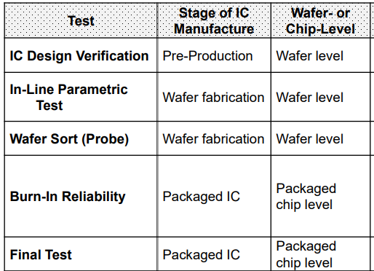
Where does the data for yield come from?
Electrical Testing data is collected via testers such as an ATE tester
In-line inspection in the foundry
This data is used by engineers to manage a healthy manufacturing lifecycle
Yield is predicted and analyzed at various test insertions (shown right)

Slide 6
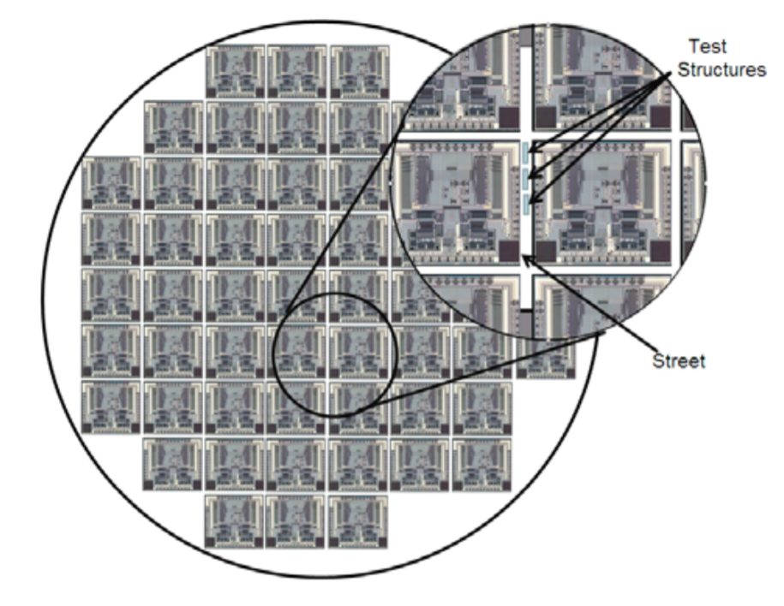
Example of scribe lines with test structures

Slide 7
What is yield?
Yield is how companies measure throughput throughout the wafers entire lifecycle. (fab to ready to ship out to consumer)
Yield in semiconductor fabrication is a function of:
Defects per unit area introduced during processing
Statical defect distribution
Die area (device size)

Slide 8
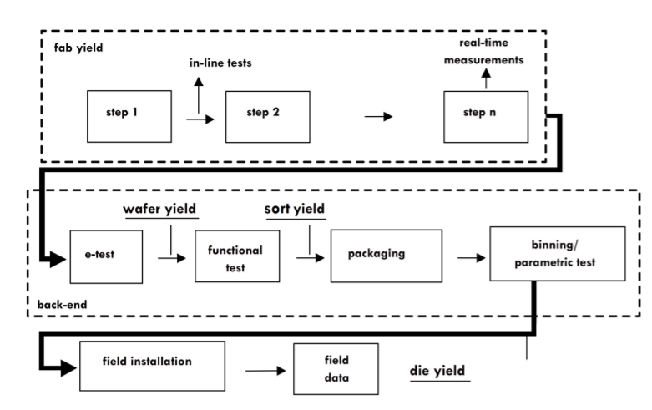
3 main yield points in product lifecycle
Notes:
Fab yield is related to the individual station yields in the fab.
Sort yield is related to e-test and die yield is after packaging

Slide 9
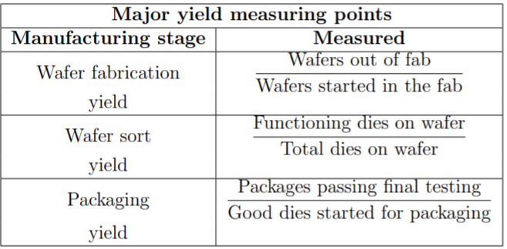
3 main types of yield in product lifecycle:
1
2
3

Slide 10
Wafer Fabrication Yield aka Fab Yield
Ratio of the total number of wafers that come out of the fab (after the end of all the individual processes, including measurement) to the total number of wafers that were started in the fab
Cumulative yield is taken since wafers go through so many individual steps
However, for each step you can have a yield parameter called: Station yield
Therefore:

Slide 11
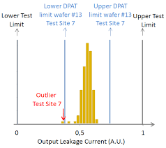
Wafer Fabrication Yield aka Fab Yield
Factors that affect overall fab yield:
Number of processing steps
Wafer breakage and warping
Process Variation or spec limits for each process
If spec limits too loose- lower yield may occur
If spec limits too tight-lower station yield ∴ fab yield

Slide 12
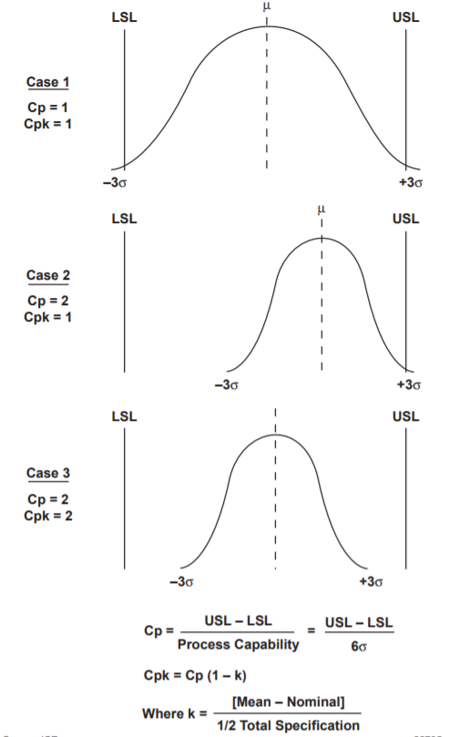
Process Variation: Cp and Cpk
Cp and Cpk measure how consistent you are to around your average performance.
Larger is better. The larger Cpk is, the less likely it is that any item will be outside the specification limits.
The ‘k’ stands for ‘centralizing factor.’ The index takes into consideration the fact that your data is maybe not centered.
Cpk tells us what a process is capable of doing in future, assuming it remains in a state of statistical control.

Slide 13
2. Wafer Sort Yield
Yield: Ratio of the number of good (functioning) dies (after electrical testing) to the total number of dies in the wafer
Sort Yield depends on:
1. Wafer diameter: wafer diameter ⬆ → number of edge dies ⬇ → yield ⬆
2. Die area: die area ⬆ → yield ⬇
If you have a large die area, you can increase wafer diameter to increase yield
3. Number of processing steps: number of process steps⬆ → defect density⬆

Slide 14
Shmoo Plots: What are they?
Shmoo Plots show the passing vs failing characteristics of a part at different voltages
Green is a passing parameter and Red is a failing parameter
Shmoos can be made with many different parameters on the x and y axis and thus can have different characteristics plots
Shmoo plots should have a linear cutoffs. Jagged edged or failures rising instead of falling are signs of part/ test failures.
Notes:
common way of characterizing a processor over a range of parameters such as supply voltage, clock frequency and temperature. When a defect occurs, the Shmoo plots are collected on a tester over multiple process corners and manual data review occurs to identify marginality and corner cases. This problem can get magnified when debugging yield problems.

Slide 15
2. Wafer Sort Yield
Sort Yield depends on:
4. Circuit density: (smallest defect size that can cause a wafer to short)
Circuit density ⬆ → number of fatal defects ⬆.
5. Defect density: background defect density ⬆ → yield ⬇
This effect is more pronounced for larger dies (see slide 17)
6. Crystal defect density:
quality of the Si wafer ⬇ → Existing defects like dislocations ⬆ → yield ⬇
7. Process cycle time:
residence time(time wafer sits between processes) ⬆ → defect density ⬆ → yield⬇

Slide 16
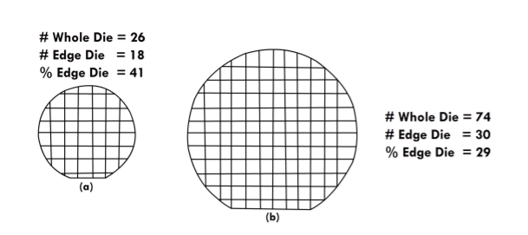
Effect of Wafer Size and Die Size
Relation between wafer size and die size effects
(a) Smaller dies have larger number of edge dies
(b) Larger wafers have smaller number edge dies, for the same die size. This leads to greater yield.

Slide 17
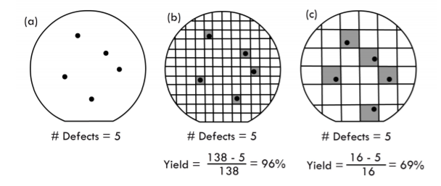
Effect of Defect Density
Effect of five random defects, i.e., background defect density
Larger die sizes will have lower yields.
(a) wafer
(b) wafer with smaller dies
(c) wafers with larger dies.

Slide 18
3. Packaging Yield
Ratio of the total number of packaged dies that pass final electrical testing (e-test) to the number of good dies that are started for packaging.
This measures the yield of the packaging process, which is a series of steps similar to fabrication process
After packaging the dies are again tested to determine overall yield.
Overall yield = wafer fab yield × sort yield × Packaging yield
Thus, all three yield points determine the final output of the IC process..

Slide 19
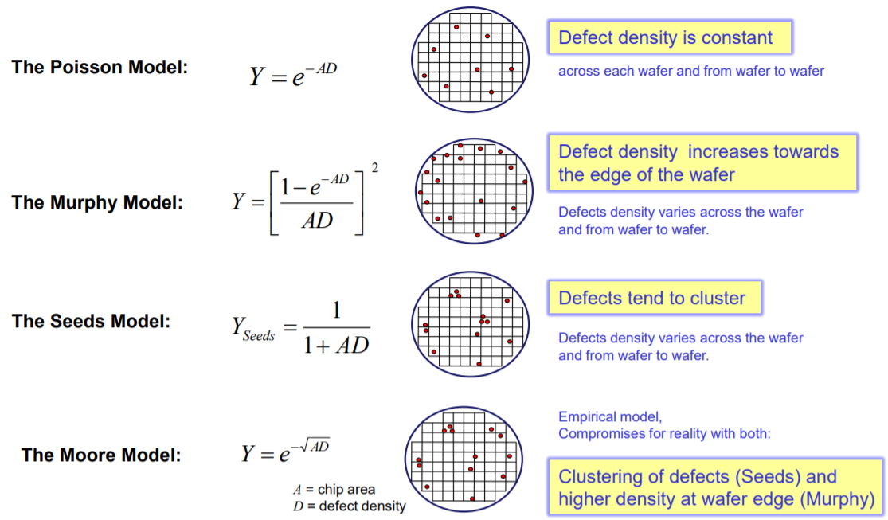
Yield Models

Slide 20
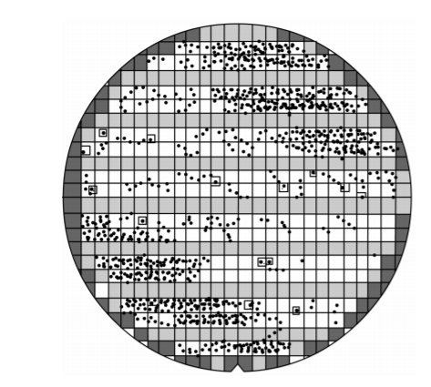
Yield models: Bose-Einstein
Clustering of defects usually occur on wafer, and are non-uniform
Estimate the impact of more complex technology options
Bose- Einstein is one of the most commonly used:
Where “n” represents the number of critical process stages
A-die area
Do-defect density [defects/cm^2]

Slide 21
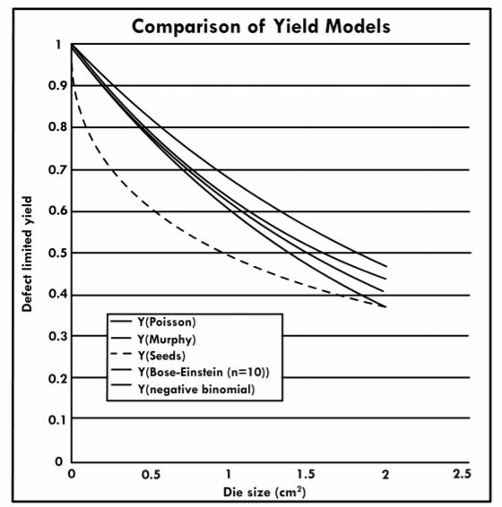
Comparison of Yield Models
Defect yield density as a function of die size for different models
Yield decreases with die size in all models

Slide 22
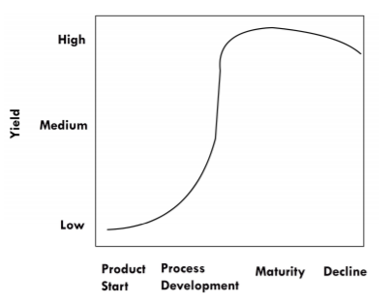
Dependence of Fab Yield in product lifecycle
Notes:
During development, yield starts very low, until the first yielding die is reached.
After that, yield increase rapidly during development and saturates during maturity.
typical fab yields are greater than 90% (this is the cumulative yield of all the individual stations)
Yield decreases slightly during transition to the next technology, since the number of wafers produced decreases.

Slide 23
How Yield Affects Costs
Fab yield affects overall cost of manufacturing
Low die yield increases cost
Yielded die cost: including fab yield in calculating cost per die
Example: Wafer cost $3000 and yielded 300 dies per wafer then cost per die is $10
BUT if yield is only 50% then cost per die is $20

Slide 24
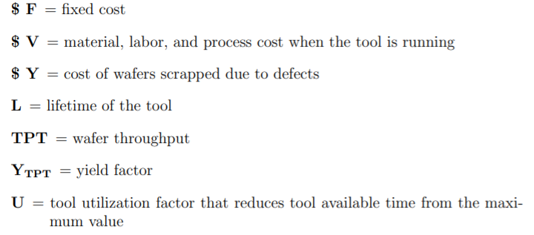
How Yield Affects Costs
Another factor is Wafer Throughput: number of wafers processed per hour

Slide 25
Interfacing with Non-Manufacturing Departments
Systematic yield losses often are results of issues related to:
Product design
Technology development & transfer
Product testing

Slide 26
Interface with product design
Design rules have been set very early in technology development stage
Problems showing up later in development are fixed by process improvements (not design rule changes)
Manufacturing these devices has become very complex
Solution: Design for manufacturability guidelines for the designers (chip architects and layout engineers)
Guidelines are not always followed perfectly by designers

Slide 27
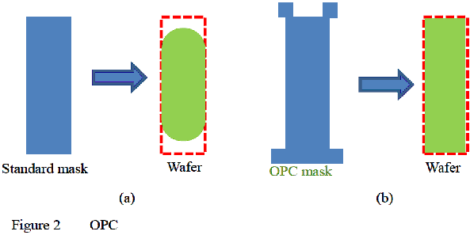
Interface with product design
Typical process improvement fixes to design issues:
Mask Changes
Resolution Enhancement techniques
Mask changes:
Correct design flaws
Improve reliability
Implement design enhancements
Fix issues detected by failure analysis engineers
Resolution Enhancement techniques:
Optical proximity effect corrections (OPC)
Phase shift masks (PSM)
Tiling to improve post planarization film thickness
Notes:
Implementations of OPC, PSM, and tiling were not carried out by the product designers, but rather by a separate mask layout department serving as an interface between design and manufacturing

Slide 28
Interface with Technology Development & Transfer
Lowering systematic yield becomes harder as new technology development is introduced
Example: Transitioning from W to Cu interconnect
Equipment develop fab has vs. product fab
Changes in process chemicals
Technology development groups have the ability to control intra-die systematics through mask layout
Modify masks
Once it is TRANSFERRED to the fab, these yield reduction options are not readily available

Slide 29
Interface with Product Testing
Best practice to improve wafer yield
Develop a complete as possible “bottom up” explanation of your yield losses
Use in-line inspection as intensively as possible
Adjust in-line inspection to detect defects or signatures of losses found at the end-of-line
Notes:
Example next page
2. For example, during demand downturns, the number of in-line inspection points and the sampling rate are increased to gather more information and improve precision. The amount of inspection is set much higher for lead products in new technologies than for mature products and technologies
3.. For example, poisoned vias could be detected by re-focusing the inspection equipment to view the bottom of the vias rather in lieu of the standard focus to search for surface defects.

Slide 30
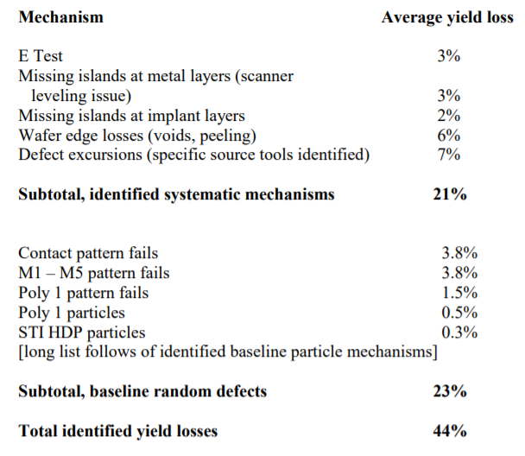
Example of Bottom-up Analysis of Yield Loss
This chart should give you an idea of how yield loss breaks down as a result of different processing factors
Bottom-up analysis explains both systematic and random losses

Slide 31
Thanks!
Questions?

