Slide 1
SCRO GBM # 4
Lecture 2: Intro to Semiconductors (part 2)
Special thanks to our sponsor:

Slide 2
Lecture 2:Intro to Semiconductors (part 2)
Learning Outcomes:
Basics of Digital logic
CMOS technology
Upcoming Lectures:
Silicon Fabrication
Silicon Characterization (process and electrical)
Silicon Testing
Silicon Reliability
Silicon Yield
Memory
And more!
Notes:
DISCLAIMER I AM NOT AN EXPERT

Slide 3
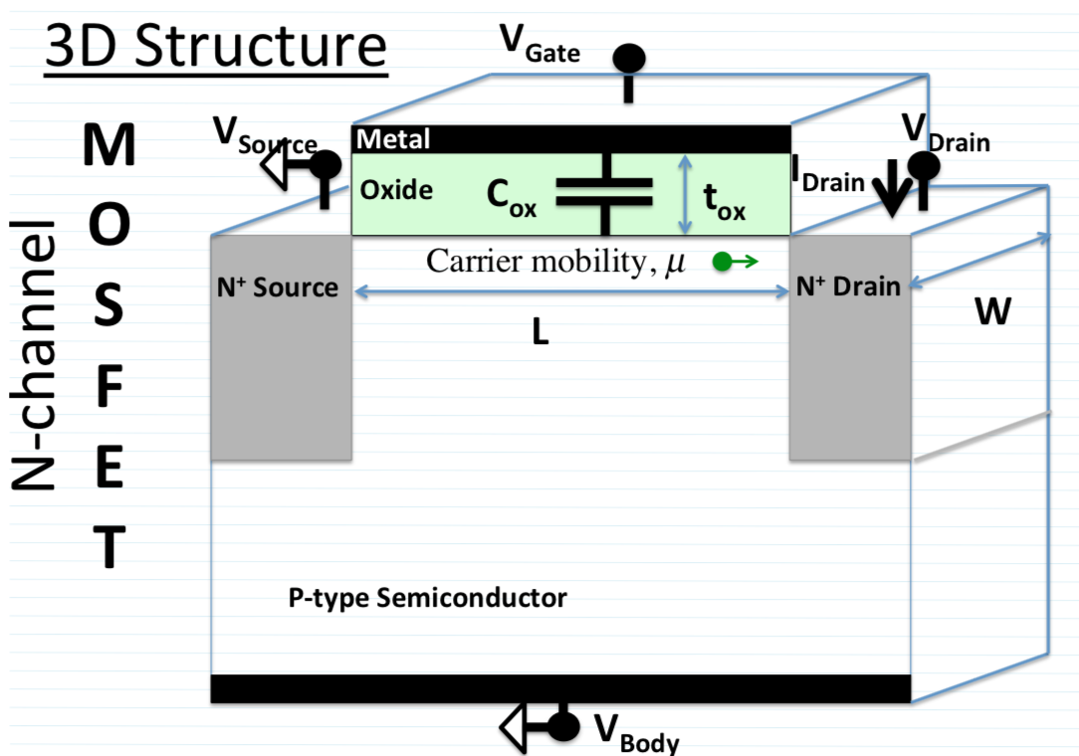
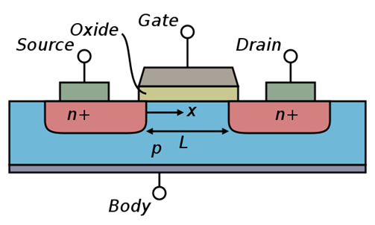
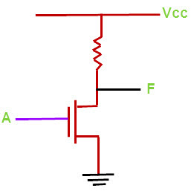
Recall an NMOS and high level overview
Switching on a N-MOSFET
1.Apply Positive Gate Voltage
2.If V_{g} > V_{t} inversion region is generated
3.If V_{d} > V_{s}: current flows along region
Here is where inversion layer forms (where current flows)
NMOS basic circuit
Notes:
NMOS is closed(current flows) with voltage on gate
PMOS is closed(current flows) with no voltage on gate

Slide 4
Switching Gears… entering the logic world
What we have covered so far….
What is a semiconductor
Basics of Doping
Basics of MOSFETS
Operation Modes for MOSFETS
Basic MOSFET Geometry and Device Physics
NMOS (PMOS is just opposite of NMOS)
Where we left off….
What happens if we put an NMOS and a PMOS together?????
We get CMOS (Complementary Metal Oxide Semiconductor)
In order to fully understand CMOS device- it is crucial to understand some basic digital logic
Notes:
We are sticking to ditgal but we are planning an analog lab that will give members the jist of the analog world… which gets a little bit tricker

Slide 5
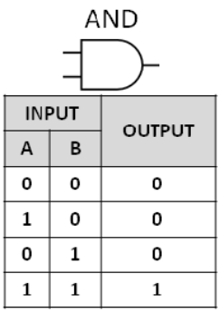
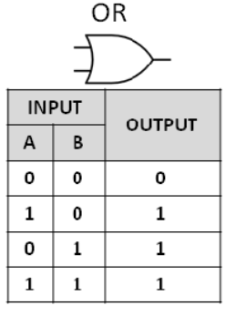
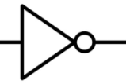
Basic Logic: AND & OR & NOT
AND gate is just a multiplication operation i. Y= A.B
OR is just gate sum operation
Y= A + B
NOT gate is just a inverse (complement) operation
Y=A^(-1)
(NOT can be represented as a NAND with both inputs connected)
Truth Table size is 2^{n}
Where n is the number of inputs
Notes:
Logical operations are based on the input values and combine to create the output
Different gates get stringed together to make different devices

Slide 6
Basic Logic: AND & OR & NOT
A
D
Practice example:
Draw the truth table for the circuit on the right.
B
E
Z
C

Slide 7
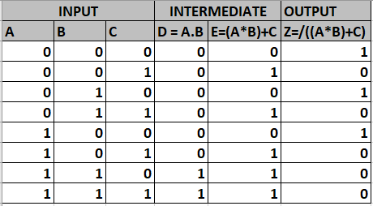
SOLUTION
A
D
B
E
Z
C
Notes:
This circuit can be taken 1 step at a time
The table is 2^3 size to represent all possible combinations of the 3 inputs
The second step is to find D, which is A and B
The 3rd step is to take the OR of the D column and the C column: following the rules
The last step is to invert the output E to get the final output

Slide 8
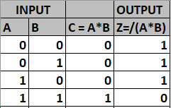
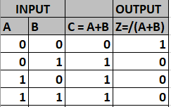
Basic Logic: NAND & NOR (important!)
NAND and NOR are AND and OR with a NOT on the output
EVERY digital circuit can be built from NAND and NOR gates
A
A
Z
Z
B
B
A
C
A
C
NOT
Z
NOT
Z
B
B
Notes:
NAND is AND and NOT
NOR is OR and NOT
The reason we use these is they are buildable from MOSFETS

Slide 9
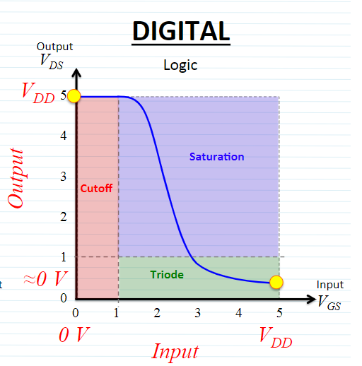
Recall Operation Modes for MOSFET
Cut-off: No current flows through MOSFET
Triode: Current flows through the MOSFET depending on Vds (drain to source)
Saturation: Current flow through MOSFET is pinched off as Vds increases into the saturation region (Analog)
Notes:
We function in Triode and cut-off when doing logic.

Slide 10
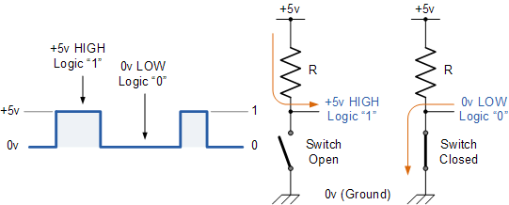
What is Logic High and Low?
Digital Circuits operate in binary space
Always 1/0 ↔High/Low ↔5V/0V
Notes:
5V is interprerted as a logical 1 and refered to as “HIGH”
0V is interprerted as a logical 0 and refered to as “LOW”

Slide 11
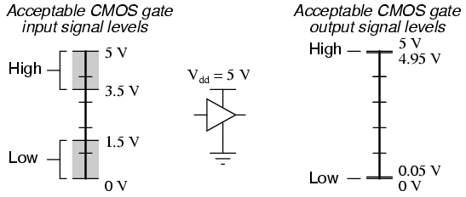
What Voltages are acceptable for CMOS?
No Man
Land
If you are in no man’s land then
BAD THINGS HAPPEN
No Man
Land
The MOSFET’s operate in Cutoff (open) or Triode (closed)
Notes:
We should never run our devices inside the set High/Low levels

Slide 12
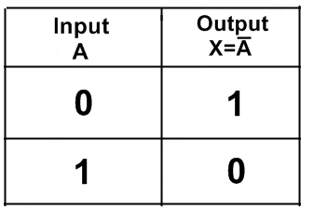
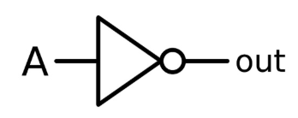
Basic Inverter (NOT) (input gets inverted)
Pull-up Resistor to Vcc(Power)
MOSFET to Ground
Input = 0 : Switch is open
Output is tied to Vcc or (1)
Input = 1 : Switch is closed
Output is pulled to Gnd or (0)
A = “0” 0V
A = “1” 5V
Input
Notes:
A signle NMOS and a resistor function as an inverter or a NOT
The switch having 0v on the gate results in an open switch, and connects the output to 5v
The switch having 5v on the gate results in an closedswitch, and connects the output to 0v

Slide 13
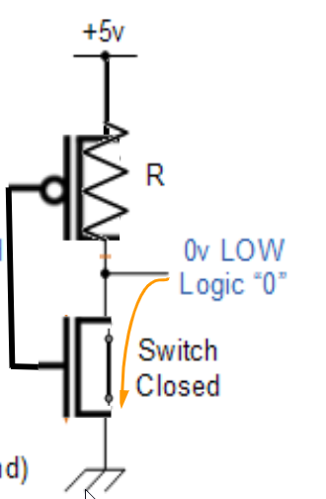
CMOS Inverter (NOT) (input gets inverted)
CMOS = NMOS +PMOS
PMOS to Vcc(Power)
NMOS to GND
Input = 0 : Switch is open
Output is tied to Vcc or (1)
Input = 1 : Switch is closed
Output is pulled to Gnd or (0)
PMOS
PMOS
NMOS
NMOS
A = “0” 0V
A = “1” 5V
Input
Notes:
CMOS uses a PMOS and an NMOS to create a NOT just like the slide above, but it performs faster than the resistor

Slide 14
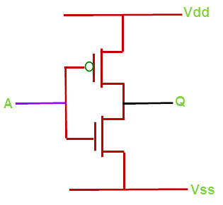
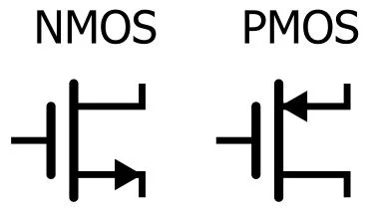
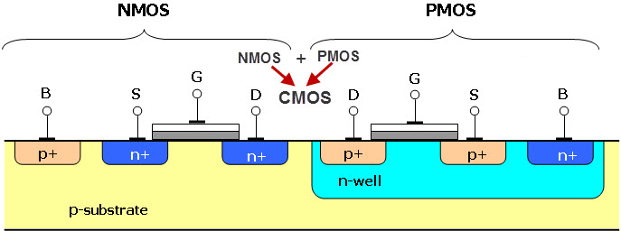
NMOS + PMOS = CMOS Inverter
Advantages of CMOS:
The circle is an indicator of PMOS
When circle is not indicated look for the arrows:
CMOS propagates both logic 0 and 1, whereas NMOS propagates only logic 1 that is VDD.
Very low static power consumption
Reduce the complexity of the circuit
High density of logic functions on a chip
High noise immunity
PMOS
NMOS
Notes:
CMOS is commonly used becuase of all the above advantages
Also commonly used as memory

Slide 15
CMOS: Complementary MOSFET Inverter
PMOS
NMOS
A
Vss
Vdd
Q
Exercise:
Where would you connect A
Where would you connect Q
Where is your voltage ground (Vss)
Where is your supply voltage (Vdd)
Important Note:
Vd is drain voltage
Vdd or Vcc or V+ is just nomenclature for a voltage supply
Vs is the voltage on the source
Vss or Vg or GND is ground (reference point to your voltage)
Notes:
In CMOS we connect the gates together
We connect the Drain of the PMOS to the Drain of the NMOS
We connect the source to the Body on the PMOS and the NMOS
This creates the gate field in the NMOS and PMOS
See the last slide show for more info on this.

Slide 16
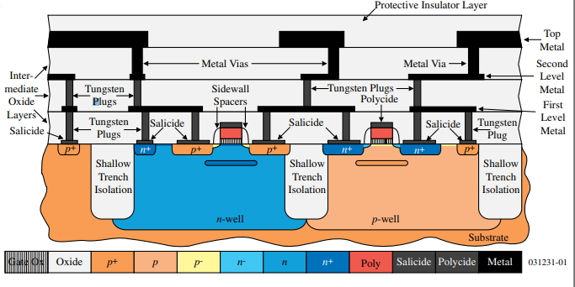
What a modern CMOS looks like, pretty spooky right?
As you can tell, the CMOS is the previous slide is oversimplified. Through our #GETUP motto we will give you the fundamentals that will allow to understand this graphic later on in our more advanced lectures.

Slide 17
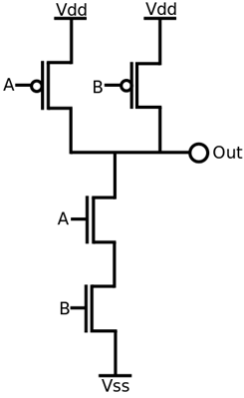
CMOS NAND
Why is this important?
We use these inverters in order to measure things like the speed of this device
For example: Ring Oscillator
A
B
Z
PMOS
PMOS
NMOS
NMOS
Notes:
This is the key connection to make a NAND device that creates all of the logic in your computer out of MOSFETS

Slide 18
CMOS NAND
A=1(5V) B=0 (0V)
Z = 1(5V)
A
B
Z
PMOS
PMOS
NMOS
NMOS
Notes:
Red represents 5V and Blue represents 0V
With 1(5V) on A input
With 0(0V) on B input
Output is 1(5V)

Slide 19
CMOS NAND A=1(5V) B=1 (5V)
A=1(5V) B=1 (5V)
Z = 0(0V)
A
B
Z
PMOS
PMOS
NMOS
NMOS
Notes:
Red represents 5V and Blue represents 5V
With 1(5V) on A input
With 1(5V) on B input
Output is 0(0V)

Slide 20
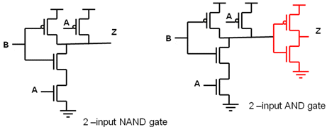
CMOS AND
To create a CMOS AND:
We use a CMOS NAND and a CMOS Inverter (NOT)
A
A
NOT
Z
Z
B
B
A
B
Z
Notes:
To make an AND we combine a NAND and and inverter

Slide 21
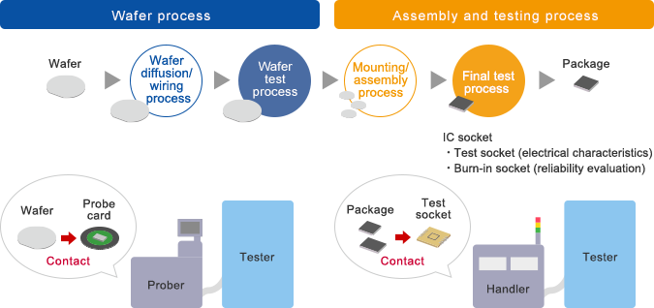
Now that we understand the basics down… Let’s look at how we can apply it to industry
Next GBM will begin to cover the Wafer Process

Slide 22
Tune in at our next GBM to see the first part of the silicon process: Wafer FABRICATION
GBM

Slide 23
Questions?
Thanks to everyone for coming out!

Slide 24
FAQ’s:
Will we learn about in depth device fabrication and techniques?
Yes we will be covering the entire wafer fabrication process AND what happens to the device outside of the fab.
(electrical testing, characterization, how the industry is producing smaller nodes (device physics and material selection), yield, and more!)
Workshops?
We will be hosting skills workshops through the year

