Slide 1
SCRO GBM # 5
Lecture 3: Process Overview
Special thanks to our sponsor:

Slide 2
Lecture 3:Processing Overview
Learning Outcomes:
Processing Steps
Advantages of techniques used in industry
Upcoming Lectures:
Introduction to memory
Silicon Characterization (process and electrical)
Silicon Testing
Silicon Reliability
Silicon Yield
And more!
Notes:
DISCLAIMER I AM NOT AN EXPERT

Slide 3
Overview: raw material to final product
We will cover test and assembly in the spring

Slide 4
Material preparation
Polycrystalline silicon is converted to "single crystal" silicon
Single crystal silicon is used to manufacture most Si-based microelectronic devices.
Polycrystalline silicon can be as much as 99.9999% pure
Notes:
Polycrystalline to single crystal: meaning that the randomly associated crystallites of silicon in "polycrystalline silicon" are converted to a large "single" crystal.

Slide 5
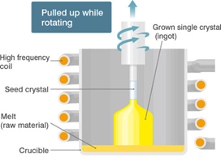
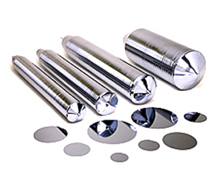
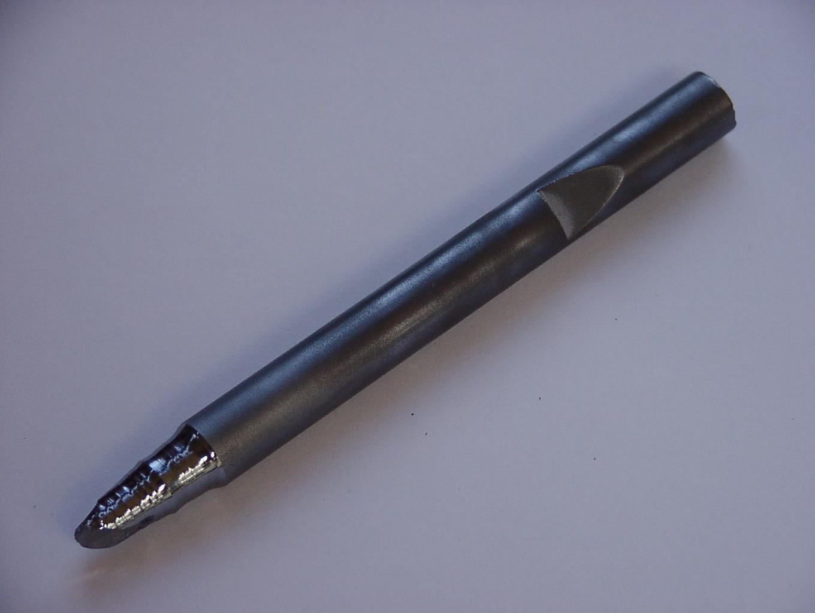
Crystal Growth
Czochralski process
A uniform seed crystal is used as the basis to form the crystal
The seed is lowered into a crucible of melted silicon
Rotating and lifting the seed causes a uniform silicon ingot to grow
Seed Crystal
Czochralski process
Ingot

Slide 6
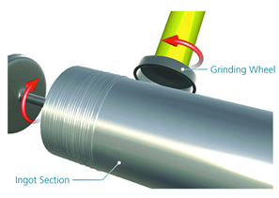
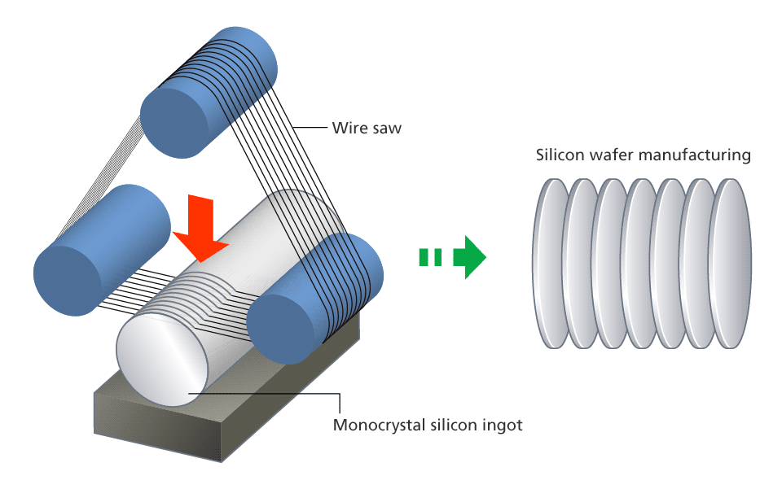
Crystal Growth: Ingot Slicing -> Makes Wafers!!!
Diameter Turning
Makes the wafer perfectly round
Ingot Slicing
Cuts the ingot into separate wafers

Slide 7
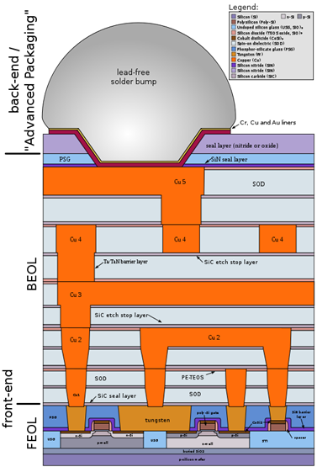
Wafer Fabrication:
The 3 main areas in wafer fabrication:
Photolithography
Etching
Deposition
Common terms used in industry:
Front end of line
Back end of line

Slide 8
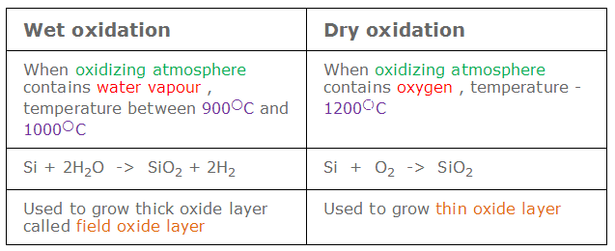
Thermal Oxidation
Grow oxide layer on silicon wafer
56% is above the wafer and 44% into the silicon surface
Slower,high-quality
Faster, low-quality

Slide 9
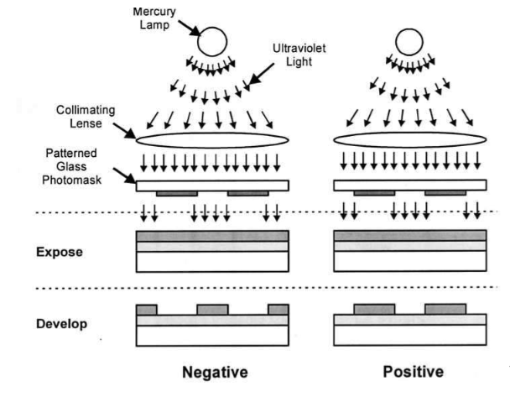
Photolithography Photoresist “PR”
Photoresist (PR)
Used to pattern new features onto the wafer
PR is UV sensitive polymer
Negative PR hardens where it is exposed
Better adhesion
Better ion implant stability
Positive PR hardens where not exposed
More expensive
Higher resolution
Notes:
Photo active compound PAC forms bonds between the polymer molecules during exposure. This is known as polymer cross linking. These cross links in a polymer hold the photoresist together during developing so the exposed portion of the photoresist is not washed away.
In postive photoresist, the polymer is insoluble in the developer prior to any exposure. When photoresist is exposed. The PAC reacts with the polymer to break down the polymer into compounds that are soluble in the developer.

Slide 10
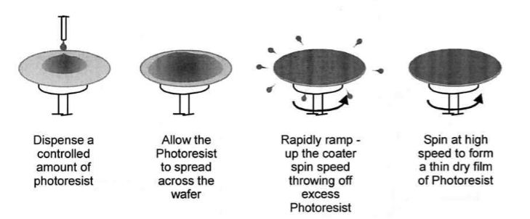
Photolithography Photoresist Spin Coating
Thickness of the photoresist, t, is proportional to the inverse of the square root of angular velocity, w

Slide 11
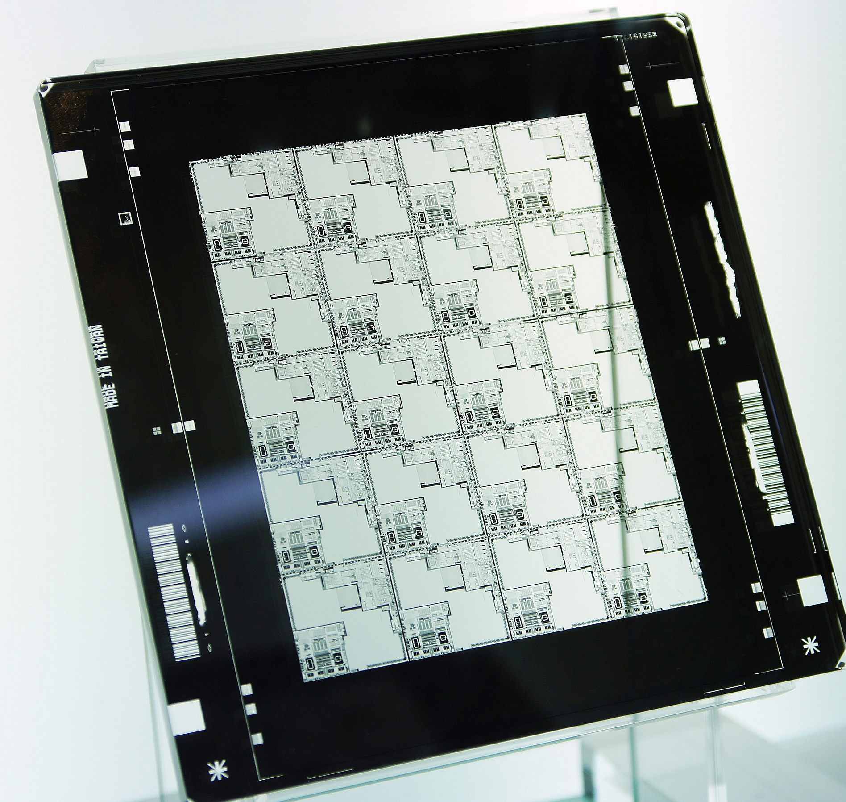
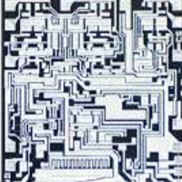
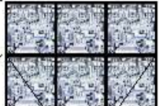
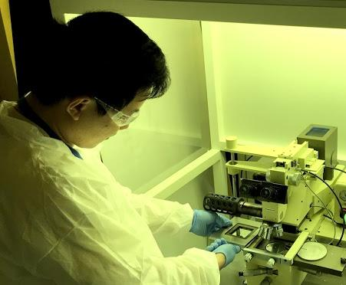
Photolithography Photomask
Photomask holds the pattern that will be exposed(with UV light) onto them photoresist layer of the wafer
Photomask containing reticle
Single Die Layout
Reticle containing a layer’s image of one or more die
Reticle exposed to UV light
Notes:
The chromium layer inside the photomask provides an opaque and mechanically strong layer to prevent light penetration through the mask.

Slide 12
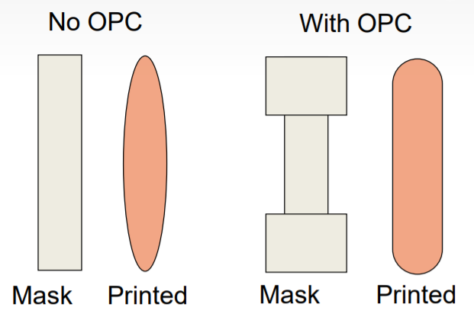
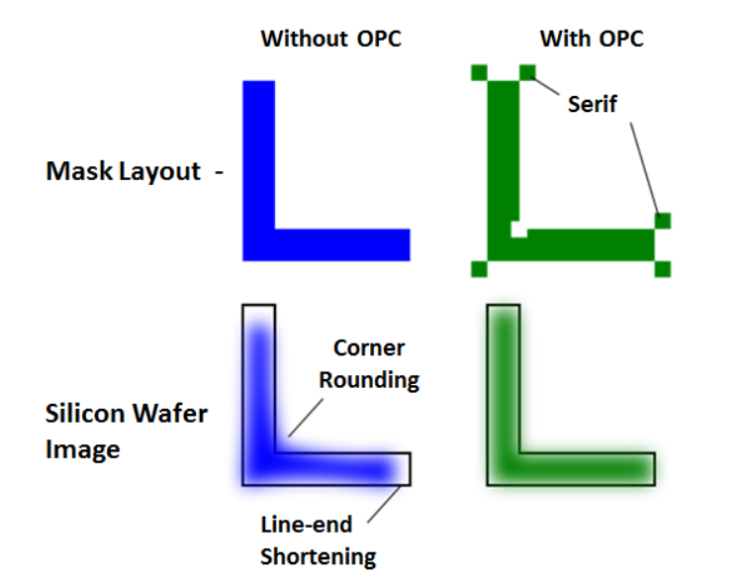
Photolithography: Optical Proximity Correction (OPC)
Optical Proximity Corrections are used to compensate for image errors due to diffraction or process effects.
Notes:
We will talk about Phase Shift Masks used for this later in the spring.

Slide 13
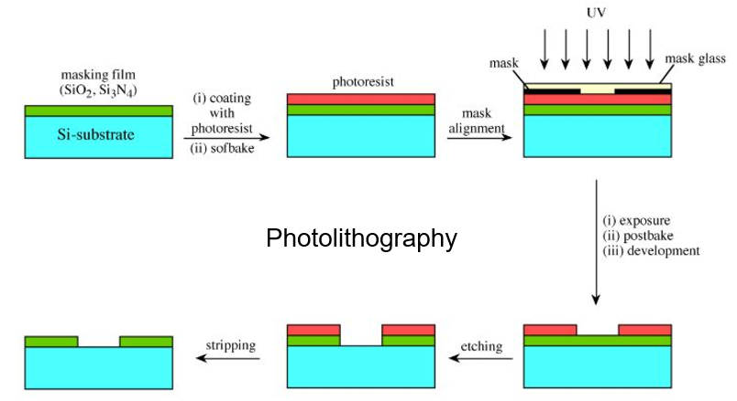
Wafer Fabrication: Photolithography Steps
Notes:
Surface preperation occurs were moisture is removed and surface ahesion treatments are applid

Slide 14
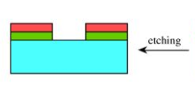
Etching
Etching Strips the material that is exposed by the photo resist
Wet Etching
Chemical Etchant
>2um
Larger volume
To etch SIO2 we typically use Buffered Oxide Etch(BOE)
Hydrofluoric acid (HF)
Buffer allows solution to stay neutralized
isotropic
Dry Etching
Ionized gas etchant(PLASMA)
>1nm
Smaller volume
Uses a high energy plasma to etch the exposed material
Advantages:
End point detection
Anisotropic

Slide 15
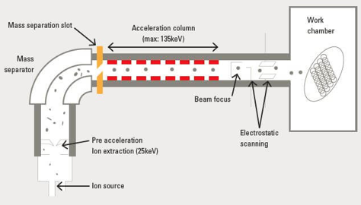
Doping (Ion Implantation) creating “wells”
Doping is the process of introducing impurities into the crystal
Ion Implantation is a method to add the ions to the wafer through acceleration
Implantation creates the n-type and p-type wafers that we discussed in the last 2 lectures
Advantages against diffusion:
Uniform dopant concentration
More directional control
Lower temperature process
Easy production of shallow layers
Better resolution
Notes:
You can also dope through diffusion depending on the technique you want to use

Slide 16
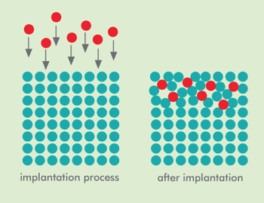
Doping (Ion Implantation) annealing
Doping is the process of introducing impurities into the crystal (source and drain)
Ions are accelerated to achieve desired depth in Silicon (energy)
Exposure time controls how many ions are deposited (dose)
Annealing after implantation will recrystallize the amorphous silicon
Annealing- heat treating above recrystallization temperature for while then slow cool
“Interstitial”not electrically active
“Substitutional” electrically active
Implantation Process
After Implantation
After Annealing
Notes:
Thermal annealing makes the impurities part of the crystal lattice which “activates” them

Slide 17
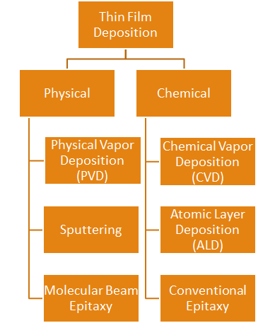
Thin Film Deposition Gate and metal layers
Thin Film deposition
Deposits a layer of a material onto the wafer
Barrier insulating/ isolation layers
Copper/aluminum (Metal) layers
There are two overall methods of deposition:
Chemical
Physical

Slide 18
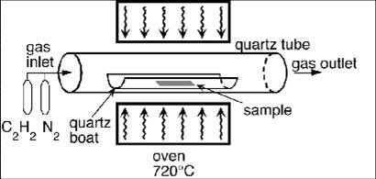
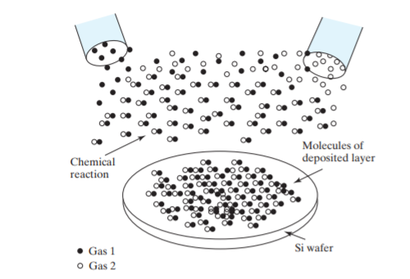
Chemical Vapor Deposition (CVD)
CVD is a method by which gaseous chemicals are flowed over the surface of a wafer to cause a thin film of material to be deposited on the surface of the wafer
This method overall produces very flat surfaces, filling in gaps and covering height differences significantly
A thin gate oxide or silicon nitride is deposited via Chemical Vapor Deposition (CVD) process to act as an insulator between the gate and the silicon

Slide 19
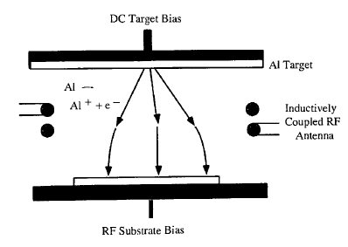
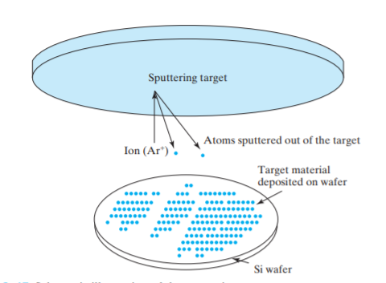
Physical Deposition: Sputtering
Sputtering is a type of Physical Deposition
Uses plasma to break down a sample which then coats the wafer(s)
Plasma ionizes the sample into reactive species which then spray toward the wafer(s)
Useful for compound coatings
DC or RF sputtering may be necessary depending on the conductivity of the compound being sputtered
Conductive polysilicon layer to form the transistor’s gate region.
Notes:
Sputtering is performed in a vacuum chamber. The source material, called the sputtering target, and the substrate holding the Si wafer form opposing parallel plates connected to a high-voltage power supply. During deposition, the chamber is ● Three Kinds of Solid ● A solid material may be crystalline, polycrystalline, or amorphous. They are illustrated in Fig. 3–16. A crystalline structure has nearly perfect periodic structure as described in Section 1.1. Silicon wafers and epitaxially deposited films (see Section 3.7.3) fall in this category as do high-quality gemstones such as ruby and sapphire (Al2O3 with impurities that produce the characteristic colors) as well as diamond. Often, materials are polycrystalline, which means the material is made of densely packed crystallites or grains of single crystal. Each grain has a more or less random orientation. The interface between crystallites is called a grain boundary. Each grain may be 10–10,000 nm in size. Metal films and Si films deposited at higher temperatures fall in this category, as do all metal objects that we encounter in daily life. Because each grain contains a large number of atoms, polycrystalline materials have basically the same properties as single crystalline materials. In particular, polycrystalline and crystalline silicon have qualitatively similar electronic properties. FIGURE 3–16 Crystalline material (a) has perfect ordering. Polycrystalline material (b) is made of tiny crystalline grains. (c) Amorphous material has no significant ordering. An amorphous material has no atomic or molecular ordering to speak of. It may be thought of as a liquid with its molecules frozen in space. Thermally grown or deposited SiO2, silicon nitride, and Si deposited at low temperature fall in this category. At high temperature, Si atoms have enough mobility to move and form crystallites on the substrate. Carrier mobilities are lower in amorphous and polycrystalline Si than in singlecrystalline Si. However, transistors of lower performance levels can be made of amorphous or polycrystalline Si, and are widely used in flat-panel computer monitors and other displays. They are called thin-film transistors or TFTs. The are also used in solar cells presented in Chapter 4. (a) (b) (c) Hu_ch03v3.fm Page 76 Thursday, February 12, 2009 12:28 PM 3.7 ● Thin-Film Deposition 77 first evacuated of air and then a low-pressure amount of sputtering gas (typically Ar) is admitted into the chamber. Applying an interelectrode voltage ionizes the Ar gas and creates a plasma between the plates. The target is maintained at a negative potential relative to the substrate, and Ar ions are accelerated toward the sputtering target. The impacting Ar ions cause target atoms or molecules to be ejected from the target. The ejected atoms or molecules readily travel to the substrate, where they form the desired thin film.

Slide 20
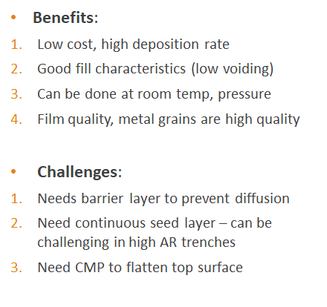
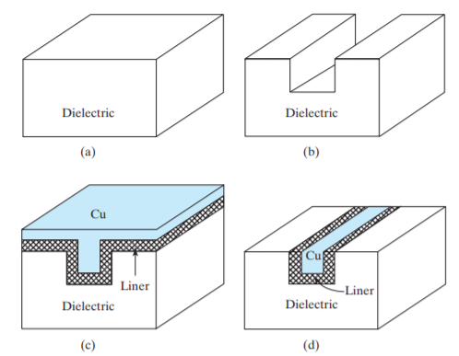
Physical Deposition: Electroplating Copper
The metallizations on integrated circuits are the electrical conductors that connect the transistors and other components on the chip
Electroplating is used to enable copper metallization
Copper lines and copper vias are used more in smaller technologies
Benefits of Cu vs. Al: ↓resistivity, ↑ thermal conductivity, ↓ electromigration
Damascene process:
Notes:
3 Basic steps of forming a copper interconnect line using the damascene process: (a) cover the wafer with a dielectric such as SiO2; (b) etch a trench in the dielectric; (c) deposit a liner film and then deposit Cu; and (d) polish away the excess metal by CMP

Slide 21
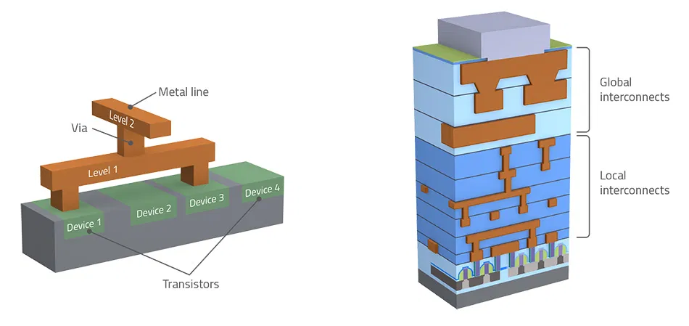
Deposition: Metal interconnects
A large number of metal layers and process steps are involved, making the interconnects take up a big chunk of IC fabrication budget. This part of the fabrication process is called the back-end line process “BEOL”

Slide 22
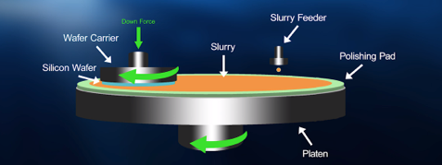
Chemical Mechanical Planarization- (CMP)
Processes like etching, deposition, or oxidation, which modify the topography of the wafer surface lead to a non-planar surface
Chemical Mechanical Processing is used as a method of material removal
Flattens the top layer of the wafer
Can also remove bumps due to features on the wafer

Slide 23
Tune in at our next GBM to learn about memory
GBM

Slide 24
Questions?
Thanks to everyone for coming out!

Slide 25
FAQ’s:
Will we learn about in depth device fabrication and techniques?
Yes we will be covering the entire wafer fabrication process AND what happens to the device outside of the fab.
(electrical testing, characterization, how the industry is producing smaller nodes (device physics and material selection), yield, and more!)
Workshops?
We will be hosting skills workshops through the year

