Slide 1
SCRO GBM #10
Lecture 7
Special thanks to our sponsor:

Slide 2
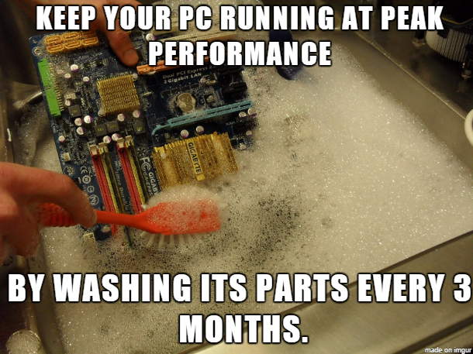
Lecture 7: Electrical Test & Reliability

Slide 3
Recall:
So far we have covered in the fall:
Device physics (Lecture 1)
Semiconductor logic (Lecture 2)
Quick overview of semiconductor fabrication (Lecture 3)
Memory (Lecture 4)
In Depth Semiconductor Fabrication Process (Lecture 5&6)
Learning outcomes:
Understand electrical testing and reliability testing is
Learn how they pertain to the industry (many jobs in these sectors!)
Different parameters to look out for in industry

Slide 4
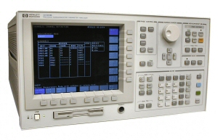
Testing a basic semiconductor
We use a Semiconductor Parameter Analyzer or “Curve Tracer” to test a MOSFET
Allows testing of basic Semiconductors
Contains: power supplies, voltage meters, current meters, and LCR meters (Inductance, Capacitance, Resistance)

Slide 5
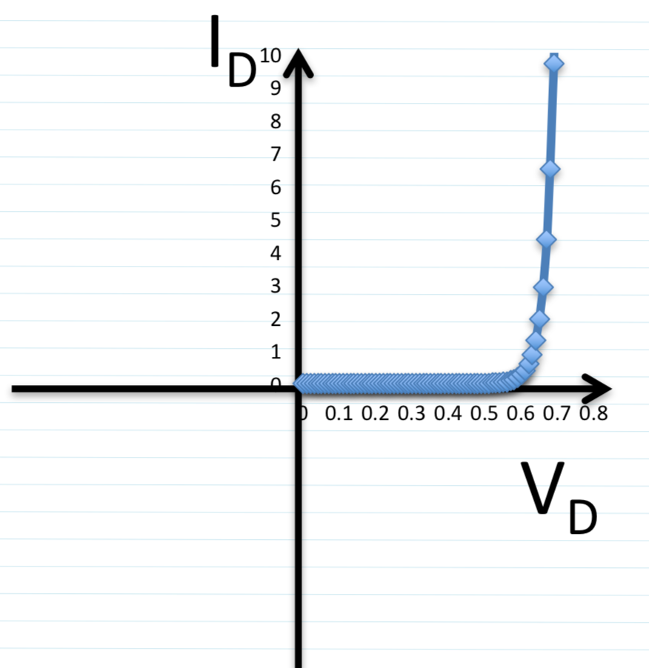
Testing a PN Diode
RECALL: PN Diodes allow current to flow when the voltage is greater than V_{TH}
Using the Analyzer allows setting the V_{D} and measuring the I_{D} going through the Diode

Slide 6
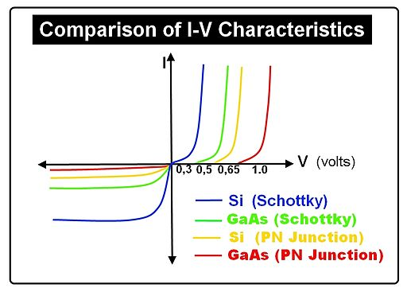
Testing different types of Diodes
Here are some graphs of the IV curves of Schottky vs PN Diodes
We can see that Schottky diodes have a lower V_{TH} then PN diodes
We also see that Si diodes have a lower V_{TH} then GaAs diodes

Slide 7
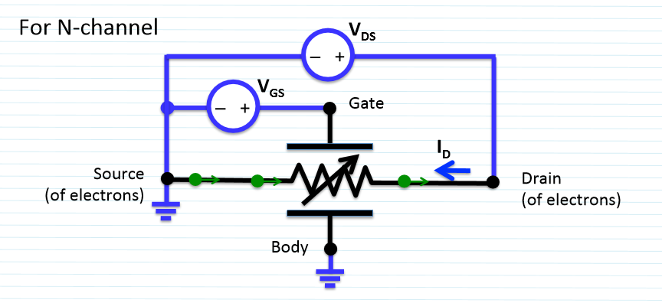
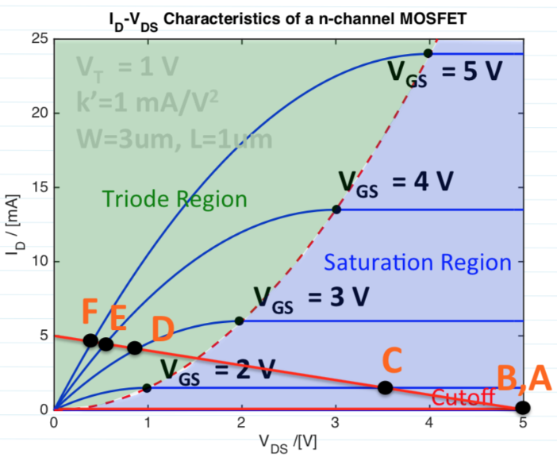
Testing a MOSFET
RECALL: MOSFETS allow varying amounts of current through based on the V_{GS}
Using the Analyzer allows setting the V_{GS} and V_{DS} and measuring the I_{D} going through the MOSFET
The generated graph looks like the one to the right, but represented by the properties of the MOSFET

Slide 8
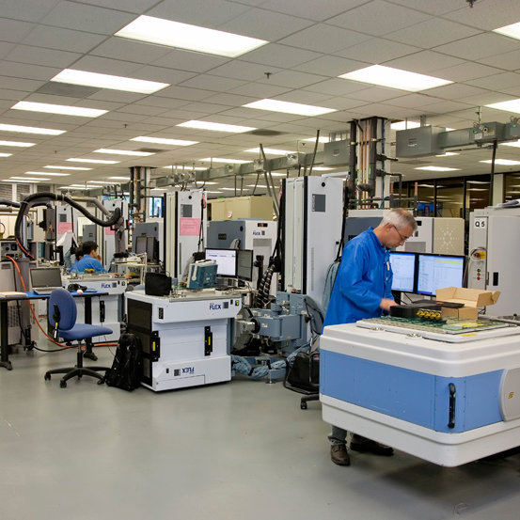
Testing in industry
They use bigger faster and more powerful testers
Common testers include the Advantest(Verigy) 93k, Teradyne Flex, and Credence Sapphire.
Some companies design their own testers
Testers are VERY Expensive
In the million dollar range

Slide 9
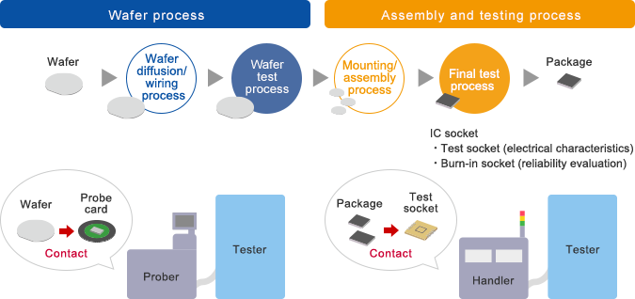
Recall: Wafer lifecycle in industry
SLT
Wafer electrical test at foundry
bumps
Wafer Sort
Die is in package at FT

Slide 10
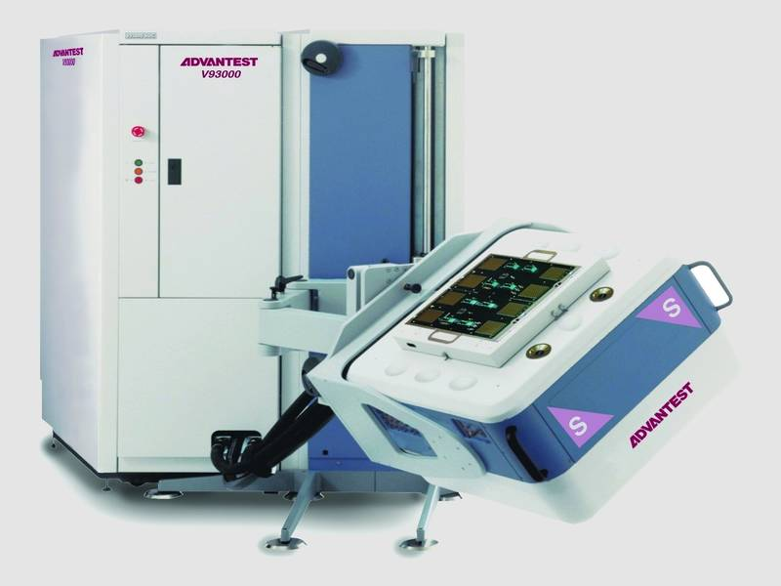
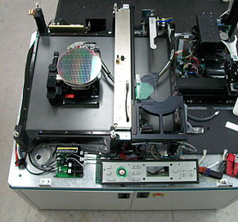
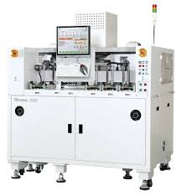
Types of Test Equipment
ATE Tester
Probe card
Final Test (Packaged)

Slide 11
What is a test vs. process insertion?
Test insertion- a step where the wafer or packaged die is subjected to a designed set of tests to determine whether dies pass/fail and measure parameters.
Process insertion- a step where wafer or packaged die is subjected to a procedure with a desired outcome
Structural tests identify sections of the die that have defect(s)
Functional tests identify operating flaw(s) in specific blocks of the die
Parametric tests measure certain attributes of the die (as a whole, or for certain sections only) – current leakage, speed (frequency), operating voltage

Slide 12
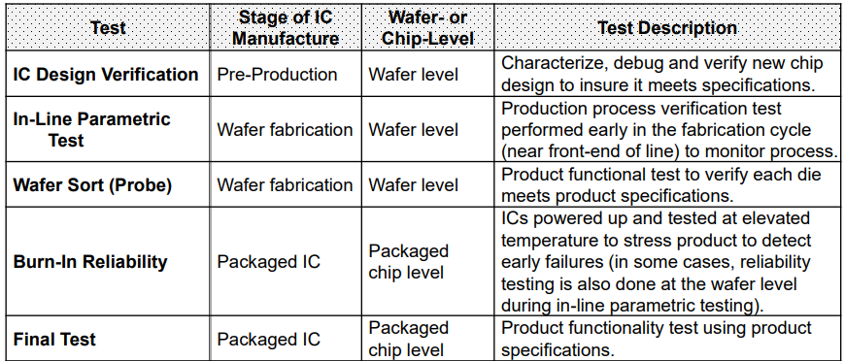
Types of Tests (General Overview)

Slide 13
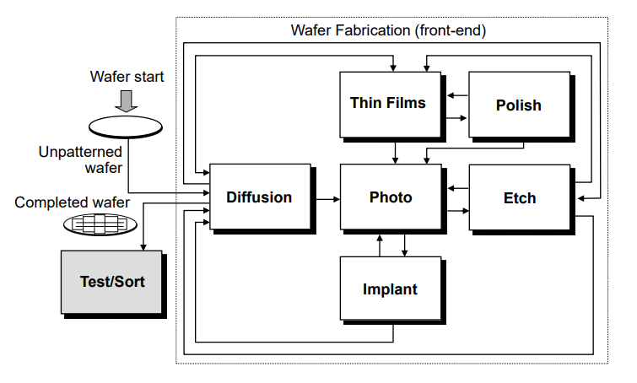
Wafer Foundry Process Flow with Test
Some tests are taken on intermediate metal layers.
Key transistor parameters are measured on the outskirts of each reticle
Usually wafer will be tested in key but random regions of the wafer to save costs

Slide 14
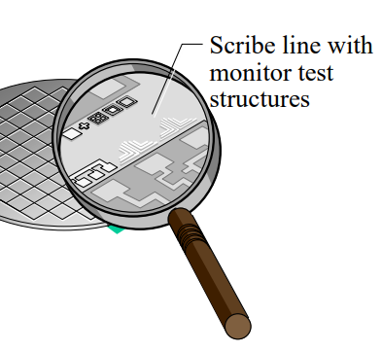
Wafer (Electrical) Test aka WET
Performed in the fab before the wafer gets sorted and bumped
In-line Parametric Test (a.k.a. wafer electrical test, WET)
In-line test structure
In-line test type
In-line test data explain
In-line test equipment

Slide 15
In-line parameter example: Ring Oscillator
Circuit that consists of an odd-number of inverting gates connected together
Ring Oscillator inverts through each inverter
Speed of the clock signal generated at Q is measured
This gives you a max speed that these gates can run (based on their propagation delay)
RO’s are used as a key way to define the speed of an SOC

Slide 16
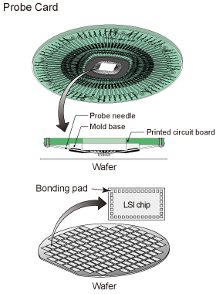
Test insertion: Wafer Sort (aka wafer probe)
Wafer is tested with an ATE system interfaced with a prober. The probe card makes direct contact with the bumps.
Objective: eliminate functional defects in die before assembly process.
Die-by-Die or multi die testing
Will classify die into pass/fail and sort different types of configurations
Maximize good die in this step to insure only good chips are sent to the next IC manufacturing stage of assembly and packaging.
Notes:
Test coverage: Achieve high test coverage of the internal device nodes at the lowest cost.

Slide 17
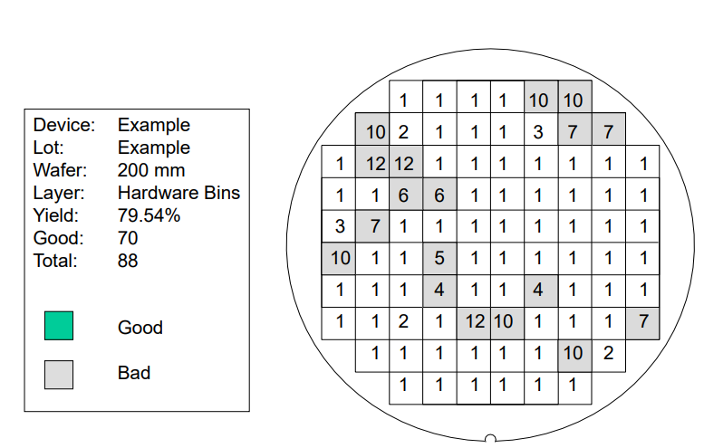
Wafer Sort: Bin mapping
Sort good chips based on operating speed/ performance (testing at several voltages & varying timing conditions)
Binning is used to "bucket" or group, units of similar performance or configuration together for analysis purposes and for logistics
Dies are often ‘recycled’ through binning process
Notes:
identify the appropriate group of passing die which have the best chance of supplying a particular market segment

Slide 18
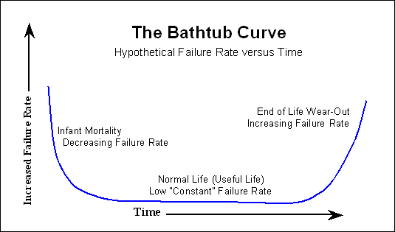
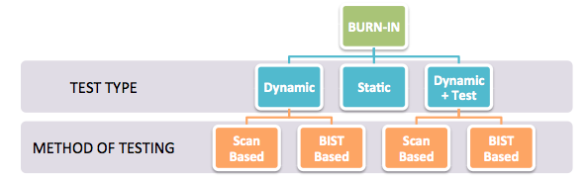
Test Insertion: Burn-In
Burn-in test is usually used to filter out devices that fail during the “infant mortality stage” (beginning of bathtub curve)
It is best to burn-in at the earliest time possible when the cost of testing and replacing parts is lowest.
Does not take into account the “lifetime” or wearout (end of the bathtub curve) – this is where reliability testing comes into play

Slide 19
What is scan?
Scan testing uses built in DFT (Design For Test) hardware to test the flip flops
Costs extra $ when building as it requires extra hardware on the silicon
Automatic Test Pattern Generation (ATPG) tool automatically generates patterns to test for different types of faults
How it works:
Pass in the test pattern to the scan chain.
Compare the output from the scan chain to the input of the scan chain
If the output matches the expected output all is good

Slide 20
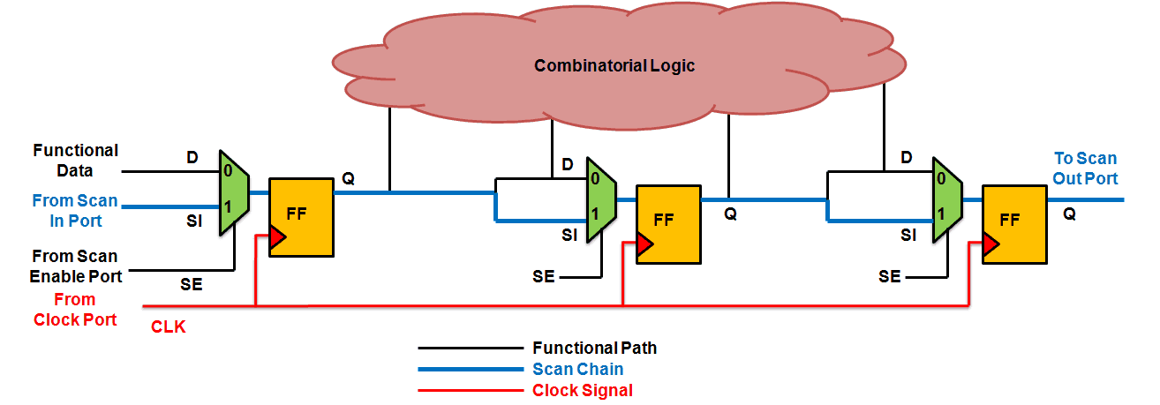
What is scan?
Scan pattern is passed into SI and read out from SO
This allow you to test all of the flip flops in the chain

Slide 21
Test insertion: Final Test
Packaged die are tested on ATE system to screen for temperature structural defects (runs higher temp)
Final product functionality test set forth by the test engineers
More accurate thermals and voltages as the part is in its final package

Slide 22
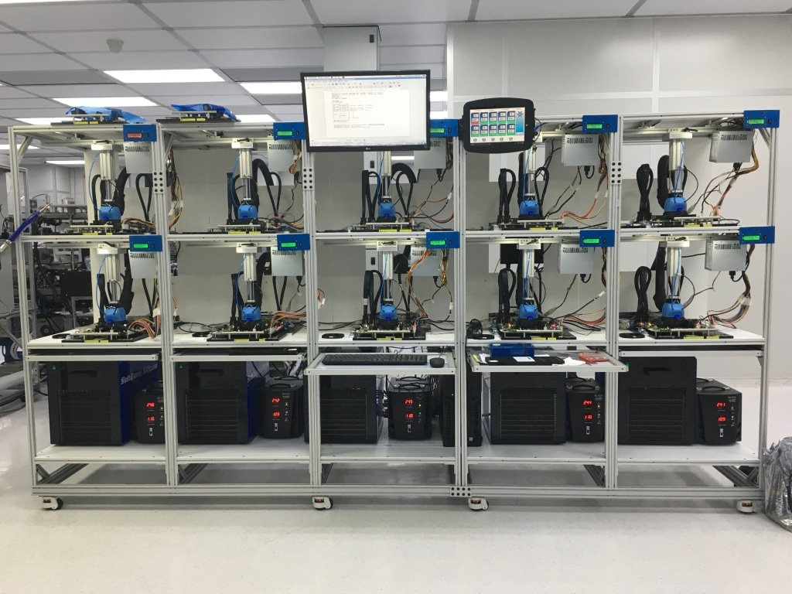
Test insertion: System Level Test
SLT uses full systems with motherboard and memory to test the SOC
Allows the running of more realistic workloads rather than being limited to test patterns
This is the last test to ensure that the parts are functioning properly.

Slide 23
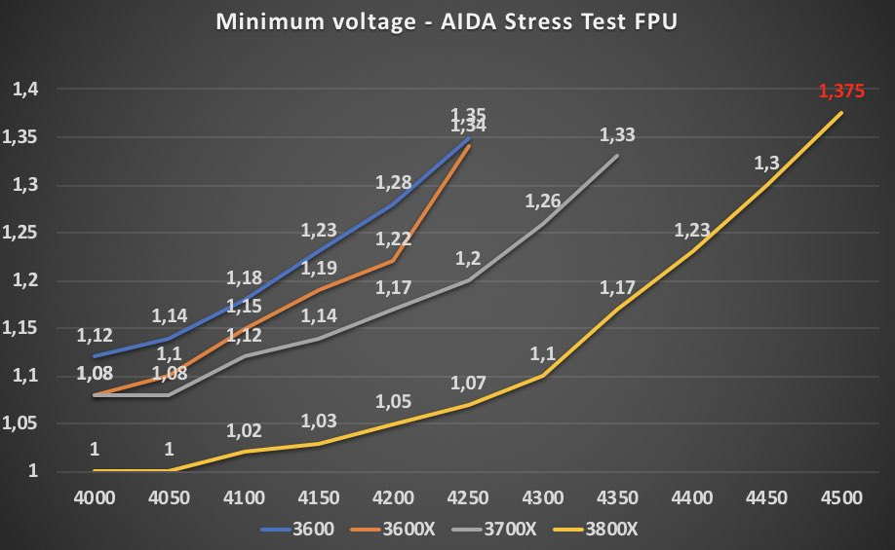
Characterization
AMD Ryzen 3000 Data
X axis Frequency
Y axis Min Voltage
To get a larger frequency, you need an exponentially larger voltage

Slide 24
Resources:
http://ic.sjtu.edu.cn/ic/dic/wp-content/uploads/sites/10/2013/04/chapter1-introduction04.pdf
http://read.pudn.com/downloads110/ebook/453506/semiconductor!manufacture!technology.pdf
https://web.stanford.edu/class/archive/ee/ee371/ee371.1066/lectures/lect_14.2up.pdf
https://www.tf-amd.com.my/wafer-sort
https://wpo-altertechnology.com/burn-in-test-eee-components/

Slide 25
Thanks!
Questions?
Tune in next GBM for lecture on yield fundamentals /JMP
GBM

