Slide 1
SCRO GBM # 3
Lecture 1

Slide 2
Lecture 1:
Introduction to Semiconductors
Notes:
DISCLAIMER I AM NOT AN EXPERT

Slide 3
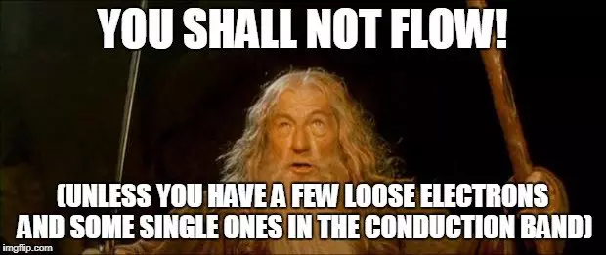
Let’s start with BASICS.
This lecture intended to a starting point for all members
Our lectures will be diving deep into real industry applications so it is important to fully understand basic principals
Learning outcomes:
Understand what a semiconductor device is
What is n-type and p-type semiconductor
Simplified current to voltage relationships
Basic Device physics you will need to know
Well what if I already know all of this?
Notes:
Answer question
We will be covering: Basic Logic, electrical applications, more device physics, FABRICATION, characterization, and memory

Slide 4
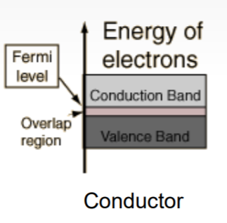
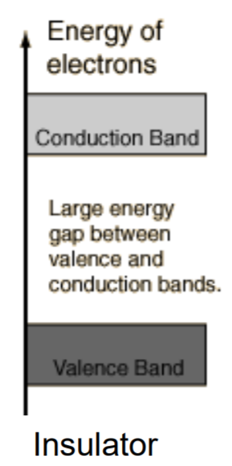
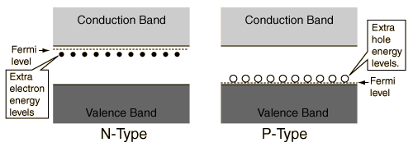
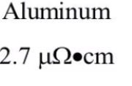
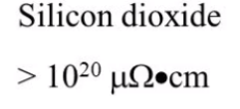
What is a semiconductor?
A conductor carries electricity like a pipe carries water
An insulator stops the flow of electricity like a plug blocks water.
A semiconductor controls the flow of electricity like a faucet controls water.
For electrical applications we use it as a SWITCH
Fermi Level– energy level where an electron has 50% probability of being occupied (midpoint of all the electrons in the system)

Slide 5
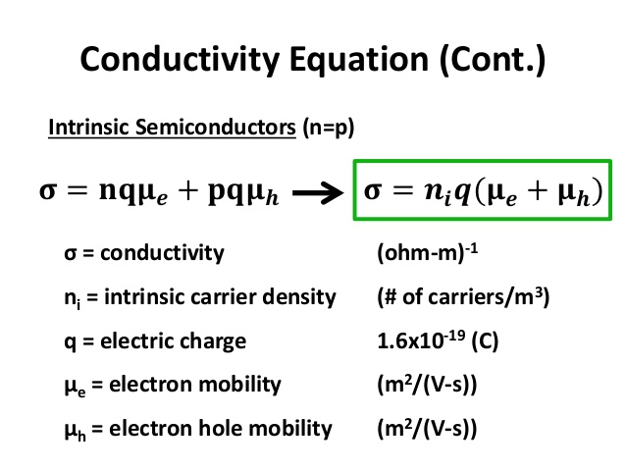
Intrinsic vs. Extrinsic Semiconductors
Intrinsic SC | Extrinsic SC
Pure crystalline structure NO impurities | Pure SC material + Impurity atoms (N & P type “dopants”)
Electrons = holes | Free electrons≠ holes N-type: excess electrons P-type: excess holes
Low electrical conductivity | Higher electrical conductivity
Temperature dependent | Temperature dependant & dopant dependant
What would the equation for N-type be?

Slide 6
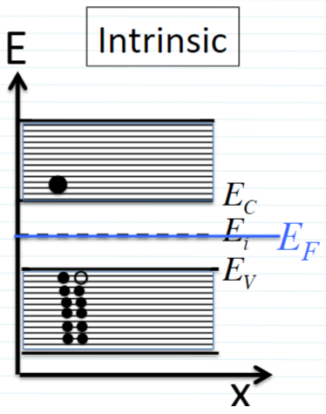
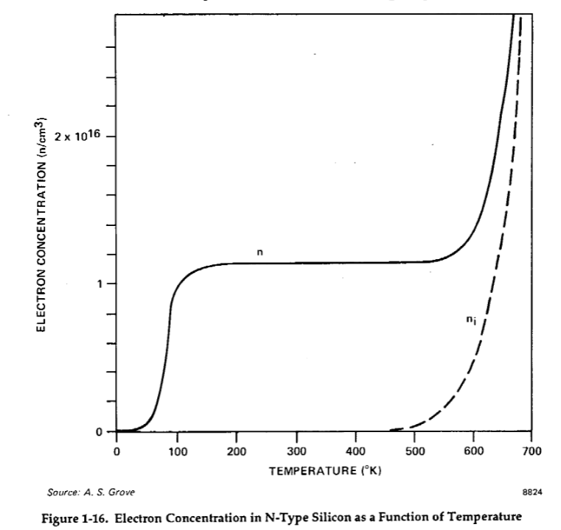
Mobility and electron density
Note: Electron mobility is faster!
Pay attention to the placement of the fermi level “Ef”
Notes:
Fermi LevelEF
– energy level where an electron has 50% probability of being occupied (midpoint
of all the electrons in the system)
–
Intrinsic Fermi Energy
,Ei– energy level in the middle of the band gap (approximately)
***Note, both of these levels are in the bandgap of a semiconductor, so
an electron cannot occupy either of these energy levels
Small amount of energy or temp for extrinsic ionizes all of the donors (n type) saturation region where all donors have given up their electrons
Stays stable and that is range of operation for the device
Small bandgap decrease the temp
Large bandgap more temp
Saturation is range of operation of device

Slide 7
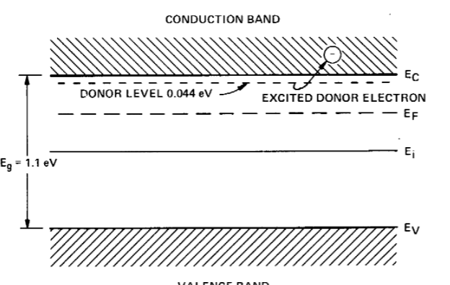
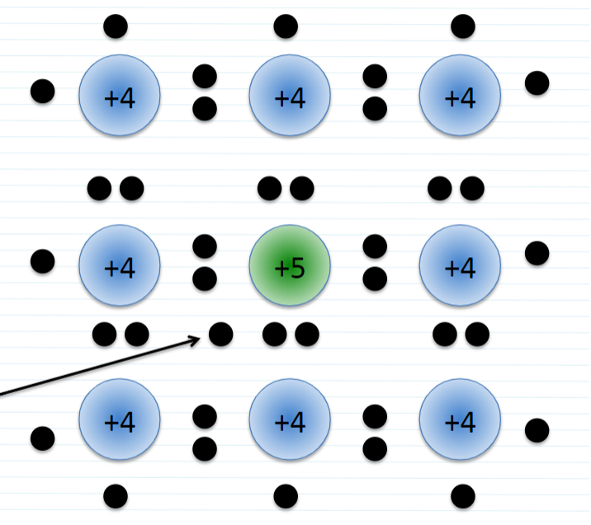
DOPANT BASICS: N-type
Notes:
Takes small energy to promote electrons into conduction band.
Donors have ionization energy of 30-45 mili eV
30-45 milielectron volts dopants
Shallow level impurties
Middle of band gap - deep level impurities are contaminants because they trap electrons from moving up
Donors and acceptors Have to be substitutional and have to bond to silicon
Conductivity carrier conc and mobility > by doping > changes electrical properties

Slide 8
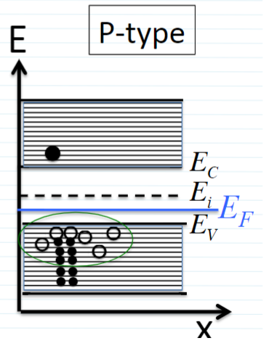
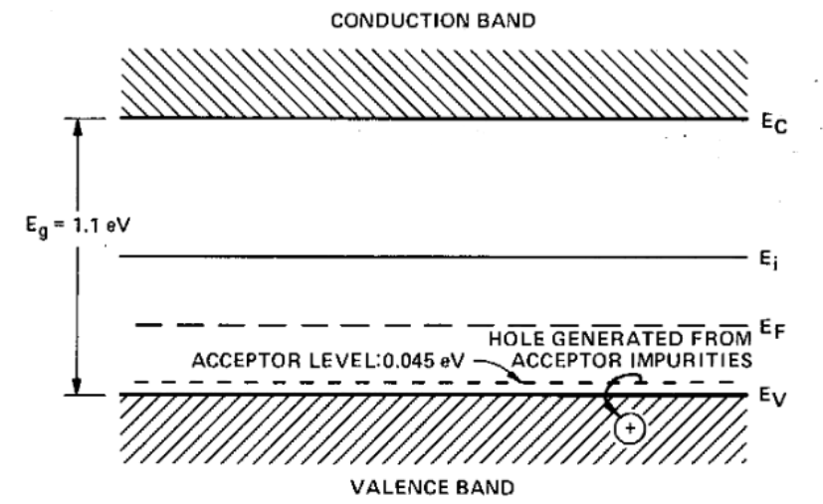
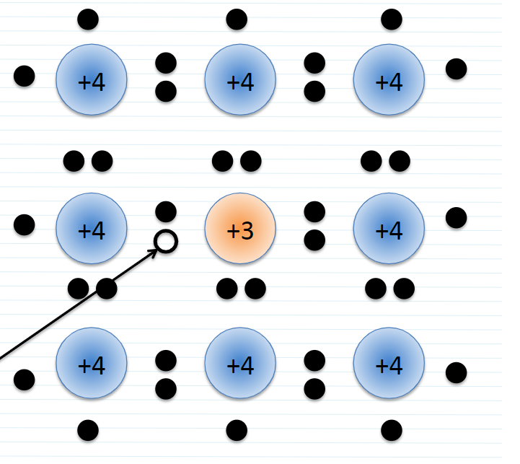
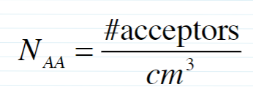
DOPANT BASICS: P-type
Notes:
Accept e- from valence band with small amount of energy, leaving behind holes

Slide 9
So how do dopants translate to electrical properties?
Higher dopant concentration = MORE carriers (electrons or holes)
Higher conductivity leads to lower resistivity
N-type silicon has lower resistivity than p-type silicon at the same dopant concentration
Why do you think this is?
Wait there’s more!!
Notes:
Answer: mobility of holes is lower than that of electrons and the difference is ude to the effective mass between electrons and holes. Electrons are faster- more conductivity therefore less resistivity.

Slide 10
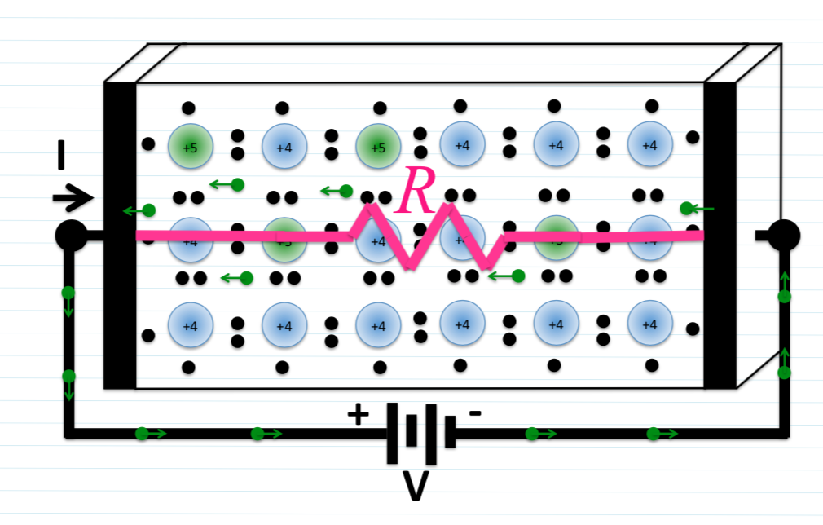
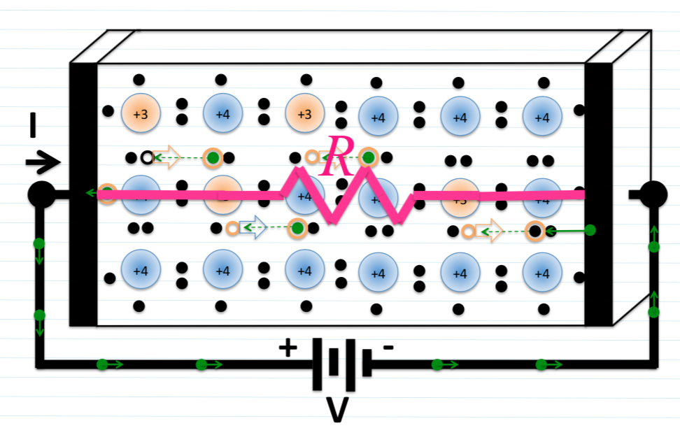
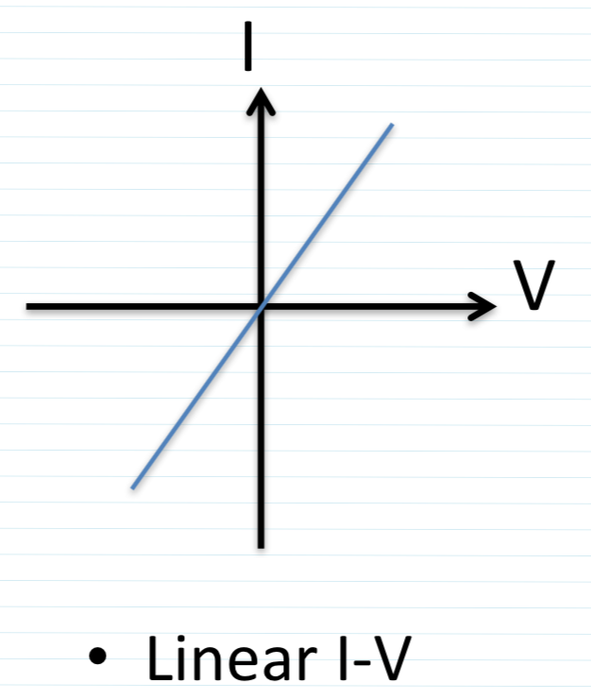
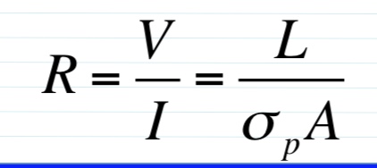
So how do dopants translate to electrical properties?
N-type
P-type
Notes:
Doped Silicon (N or P) act as a resistor!
Therefore they have a linear current to voltage curve
Well what if we put a P and N together???

Slide 11
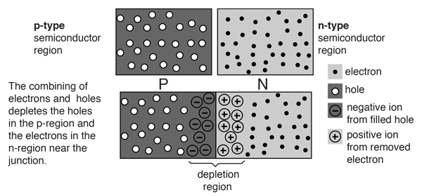
Formation of Depletion Region in P|N junction
P
N
Electric Field
Notes:
Large dopant density gradient at intersection causes free carriers to diffuse, until enough carriers cross over to repel diffusion of more carriers. These carriers are now locked in position in a region called the “depletion region”.
Electrons diffuse from high concentration to low
Holes diffuse from high concentration to low
The movement of electrons from high to low gives what we call “diffusion current”
Where each electron or hole diffuses out of forms a “depletion”
Depletion layer has a fixed depletion charge.
The diffusion current, which flows from the p to n region, is exactly balanced by the equal and opposite drift current.
When an electric field is applied across the semiconductor material, the charge carriers attain a certain drift velocity . This combined effect of movement of the charge carriers constitutes a current known as "drift current". Drift current density due to the charge carriers such as free electrons and holes is the current passing through a square centimeter area perpendicular to the direction of flow.
QUIZ: What would happen if P side is much heavier doped than N. What would the relative size of depletion regions be?
Answer: If P side is heavier doped, then the depletion regions on P side will be smaller width, since the same electrons will have to travel smaller distance to fill up holes.

Slide 12
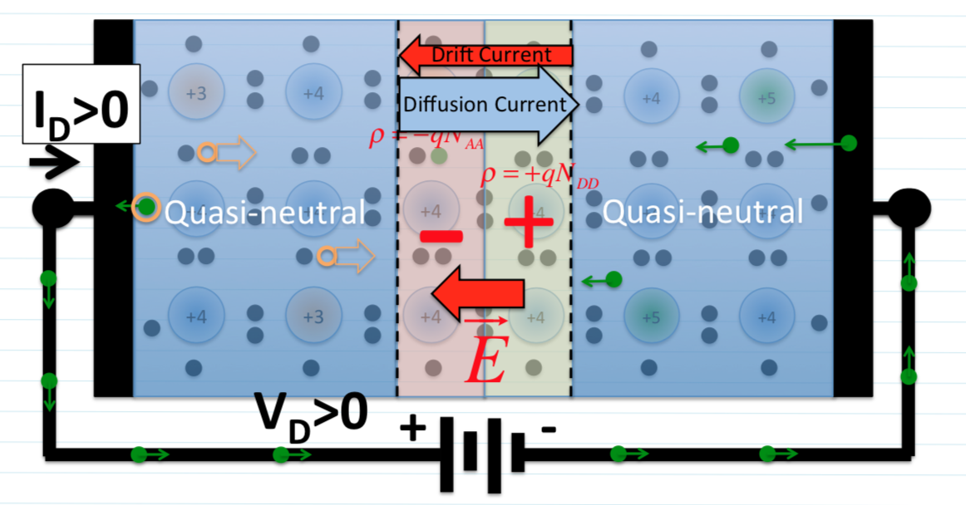
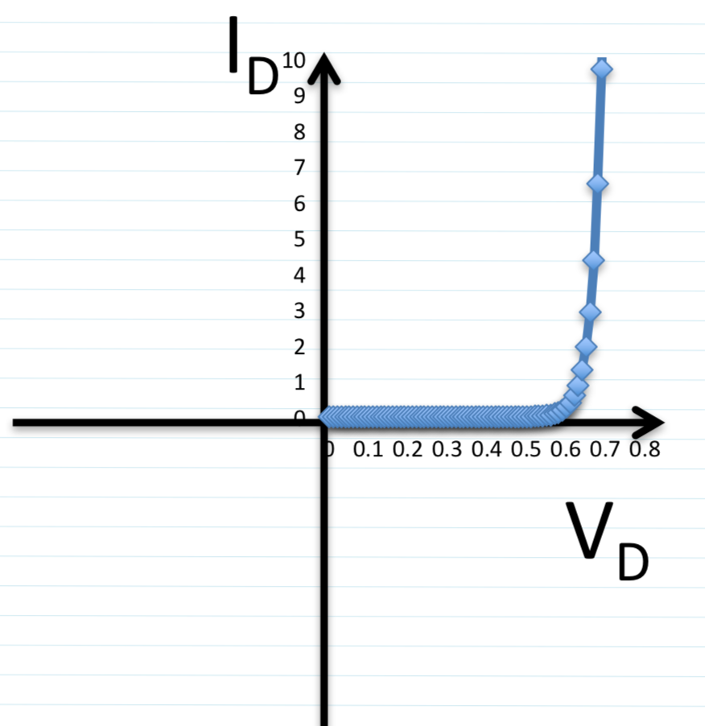
P|N Device (Diode) Forward Bias
Notes:
Positive voltage tips the balance, unleashing a flood of positive diffusion current.
Typical Threshold voltage of a diode is 0.7V.
Current flows through the P|N junction at 0.7V

Slide 13
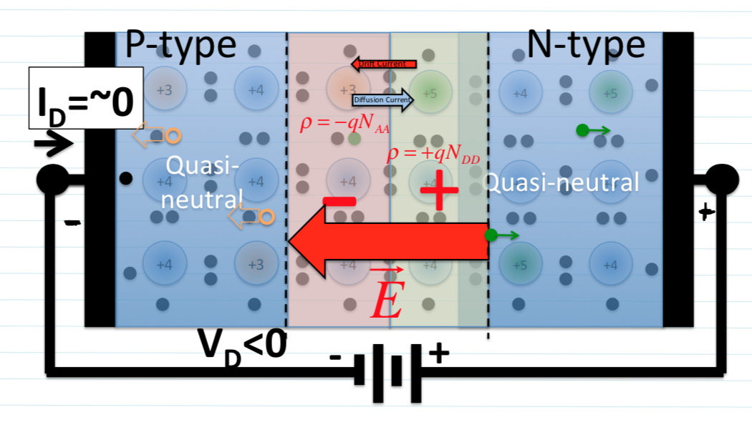
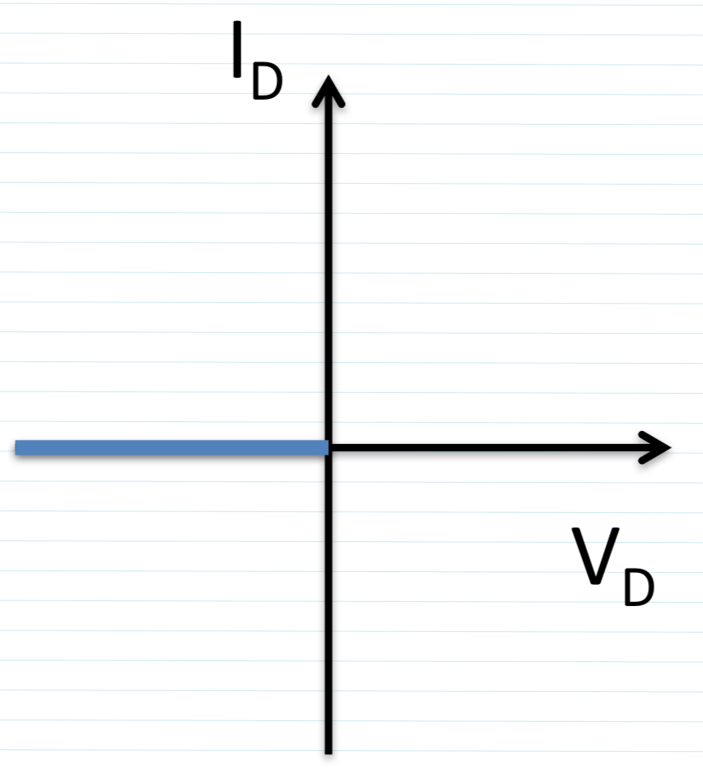
P|N Device (Diode) Reverse Bias
Notes:
Negative voltage pulls charge away, widens depletion layer, and increases E-field
No current flows through the Diode in reverse bias

Slide 14
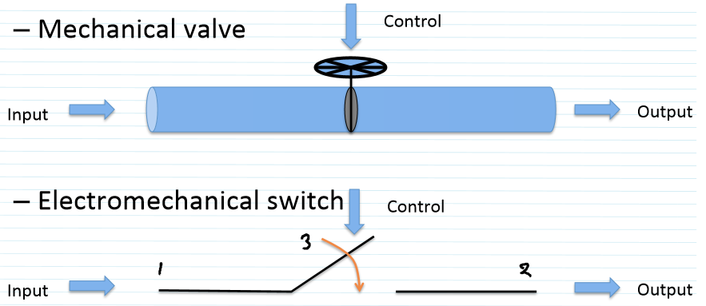
Transistor Switch
Transistor is a switch
The switch can vary from closed to open and everything in between
Allowing none, some, or all the current to pass through

Slide 15
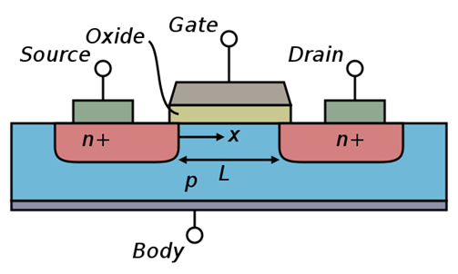
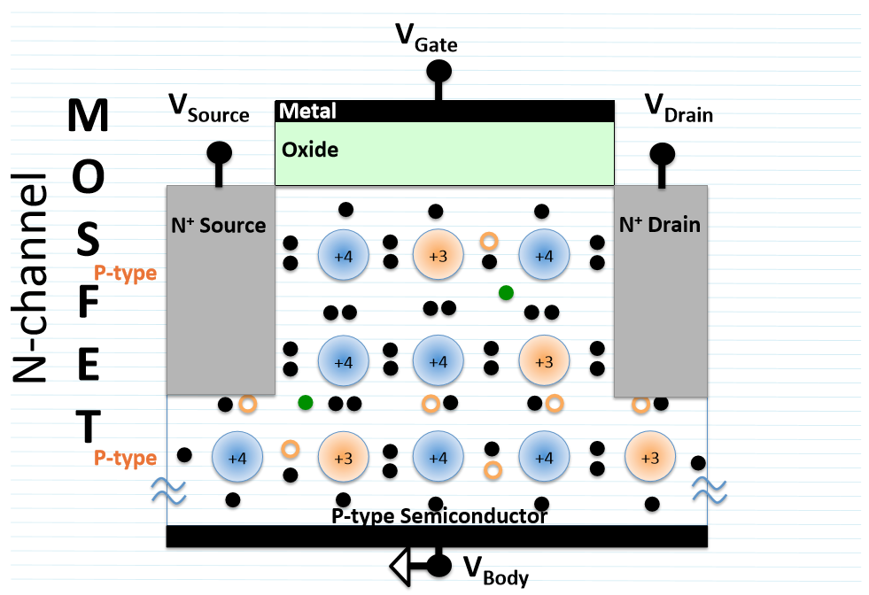
MOSFET
Metal Oxide Semiconductor Field Effect Transistor
N channel Mosfet
Built on a P type material
Gate is the control of current flow
2 N type wells attached to source and drain
Voltage difference from gate to body creates an electric field that opens and closes the flow from drain to source
Notes:
DISCLAIMER: We are talking only about Nchannel MOSFETs today
Field Effect comes from gate through to body. Body is grounded to source.
No current through oxide!!

Slide 16
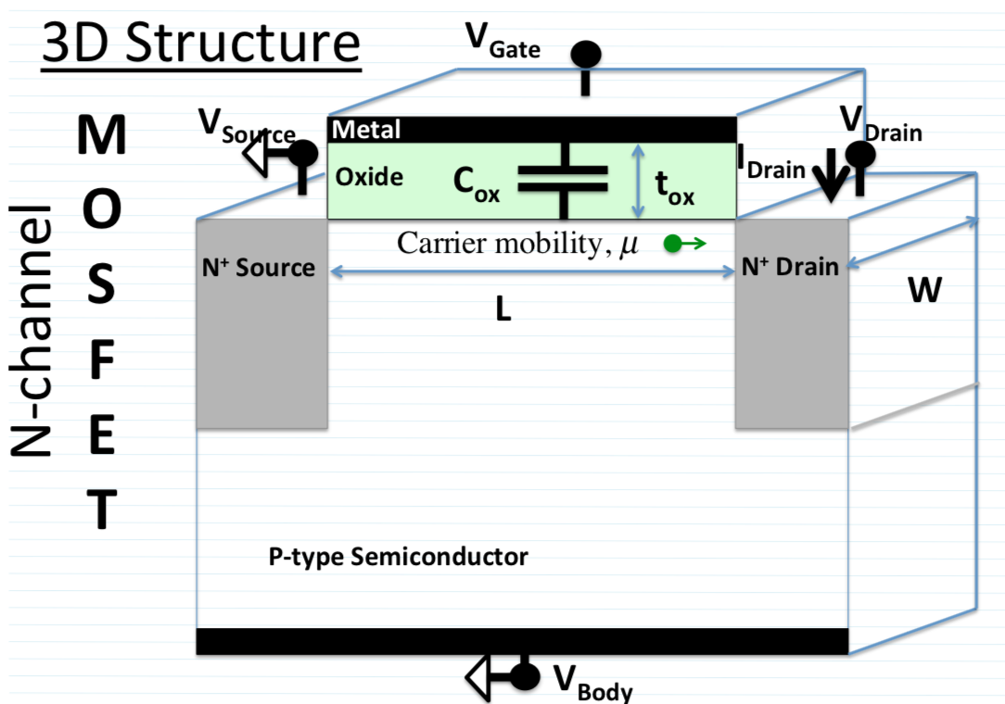
Current flow in MOSFETS
Potential on Gate electrode forms inversion channel through vertical electric field.
Potential on Drain electrode causes current to flow across inverted channel through lateral electric field.
The 'channel' is what the inverted layer of electrons close to the surface is called.

Slide 17
MOSFET DIMENSIONS:
FASTER, SMALLER, LESS LEAKY
W = Width of transistor
usually, increasing W increases footprint on wafer
L = Length of transistor
every new technology node tries to reduce this
μ = Mobility of the channel
“speed limit”
We can use fancy materials in and around the channel to modulate this
C_{ox} = Capacitance of the gate oxide
“ strength of the gate”
V_{GS} = Applied gate voltage relative to source
scaled down along with L
Can reduce t_{ox}
done with each technology node (also increases gate leakage, reliability issues)
Can increase k by changing oxide materials
done in newer technology nodes
Can increase A (gate area)
bad if footprint on wafer increases

Slide 18
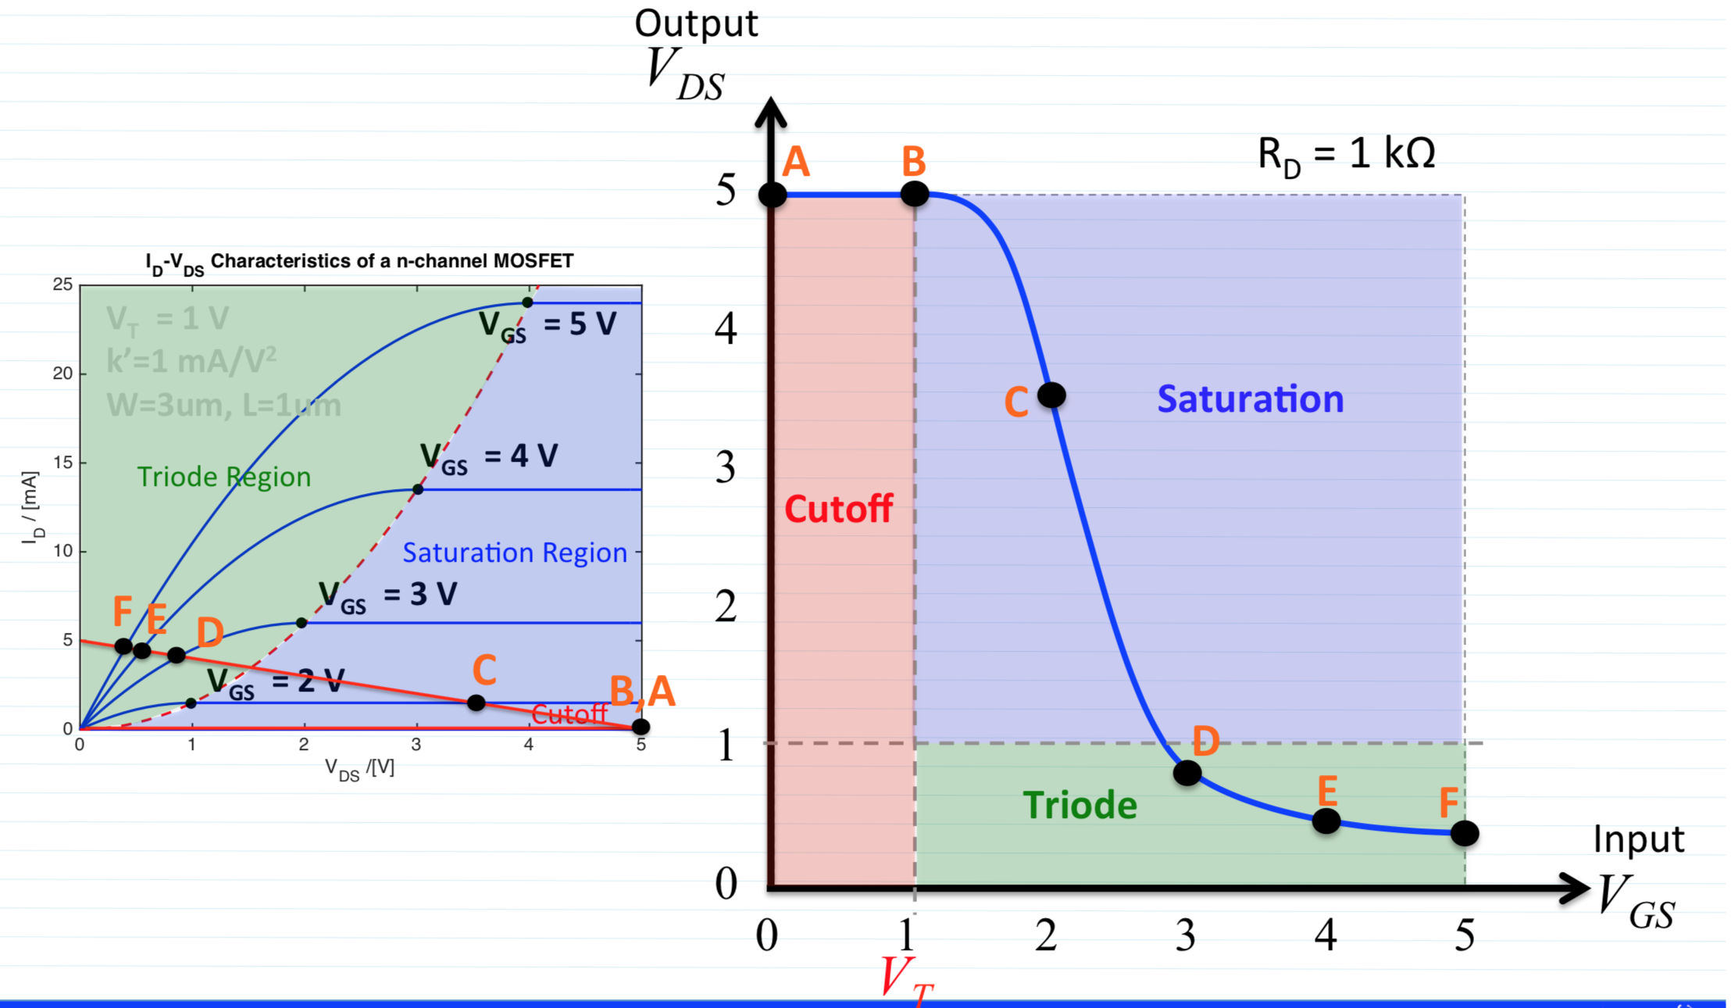
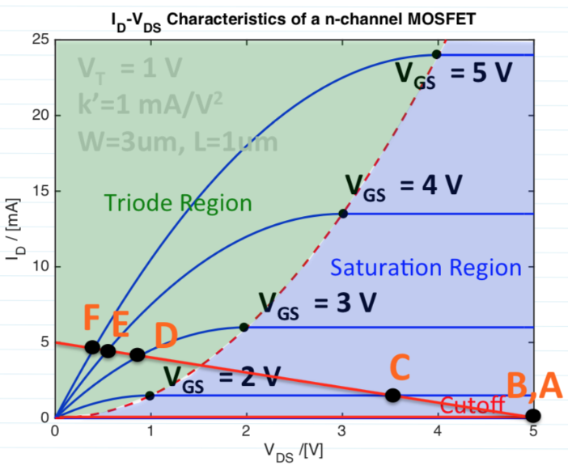
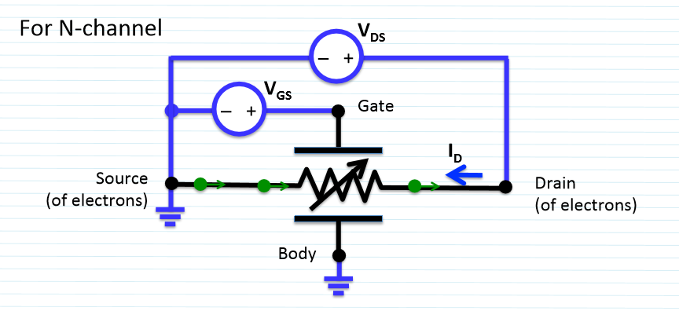
Current vs Voltage of a MOSFET
N channel Mosfet
Current flows from drain to source when a voltage is applied to the gate
Almost no current flows through the gate oxide
Current flowing through the gate is called leakage.
Notes:
Vgs is the same as Vgb(gate to body): source and body are connected together in an N channel Mosfet
Vgs: current does not flow expect leakage current (bad):
The field caused by the gate to body voltage is the “Field Effect” in FET that makes the device function
Left Chart illustrates the operating mode of the transistor based on the Gate voltage and the drain to source voltage(Vds)
Right chart illustrates the Current vs Voltage graph of the MOSFET at a set Vgs.
This shows where the device goes into saturation and no more current will pass through the device regardless of Vds increase

Slide 19
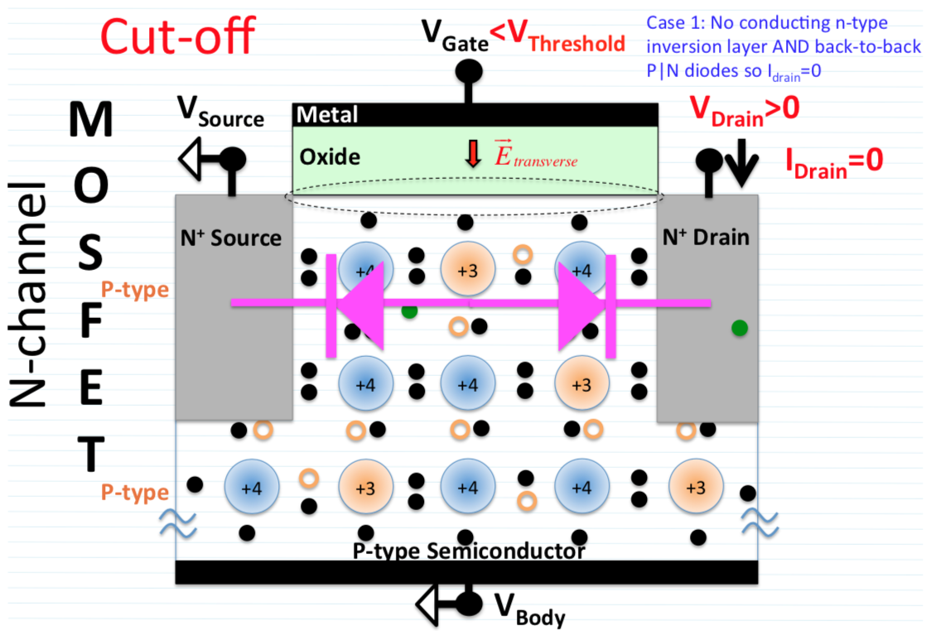
Cut-off: No current flows through MOSFET
Notes:
When the Gate to Body voltage is below Voltage Threshold Vt: the device is in cutoff and no current flows Vds.
Switch is closed!
Creates 2 PN junctions that prevent the flow of electrons in both directions

Slide 20
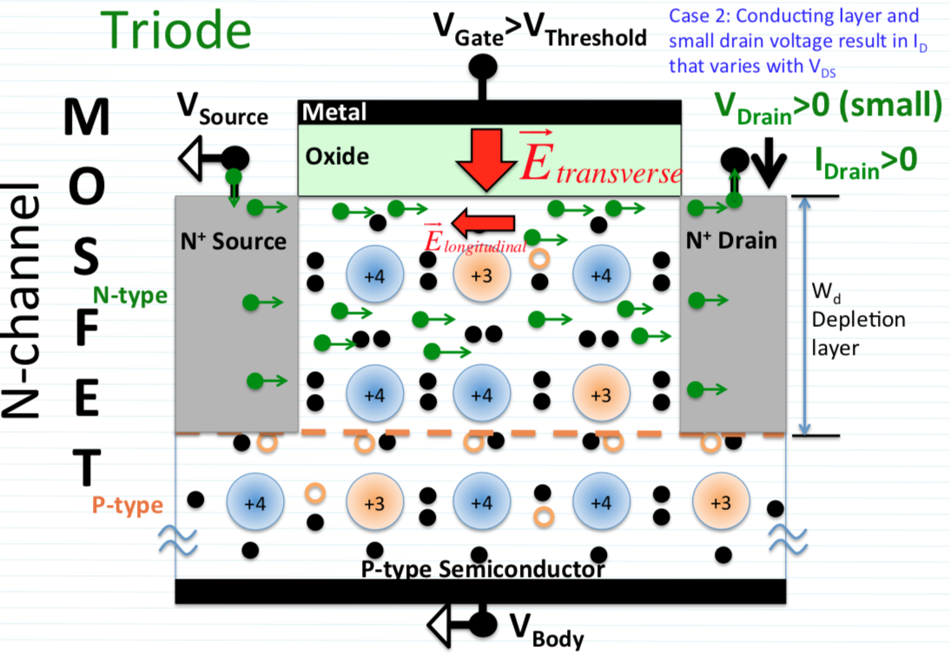
Triode: Current flows through the MOSFET depending on Vds (drain to source)
Notes:
When the Gate to Body voltage is above Voltage Threshold Vt and Vds is SMALL relative to Vgs: the device is in triode .
Switch is completely open!
Current flows through the inversion channel that gets created by the gate to body field.

Slide 21
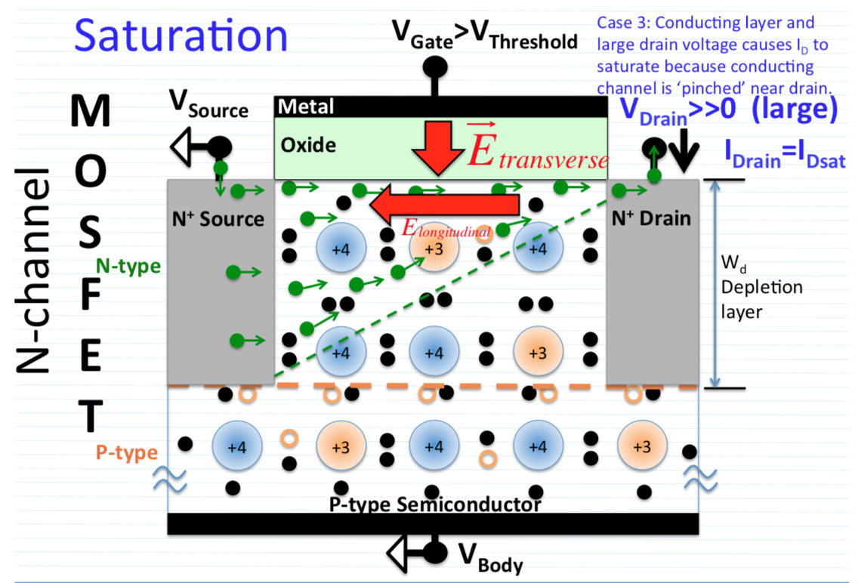
Saturation: Current flow through MOSFET is pinched off as Vds increases into the saturation region
Notes:
When the Gate to Body voltage is above Voltage Threshold Vt and Vds is LARGE relative to Vgs: the device is in saturation .
Switch is pinched off!
The current flow is saturated for the given gate voltage.

Slide 22
But wait, what if we put a NMOS + PMOS….

Slide 23
Questions?
Thanks to everyone for coming out!

Slide 24
FAQ’s:
Will we learn about in depth device fabrication and techniques?
Yes we will be covering the entire wafer fabrication process AND what happens to the device outside of the fab.
(electrical testing, characterization, how the industry is producing smaller nodes (device physics and material selection), yield, and more!)
Workshops?
We will be hosting skills workshops through the year

