Slide 1
SCRO GBM #8 Lecture 5
Special thanks to our sponsor:

Slide 2
Lecture 5: Lithography & Etching

Slide 3
Recall:
So far we have covered in the fall:
Device physics
Semiconductor logic
Quick overview of semiconductor fabrication
Memory
Learning outcomes:
Understand what photolithography and etching is used for
Learn how to apply these techniques in the Summer Lab
Different parameters to look out for in industry

Slide 4
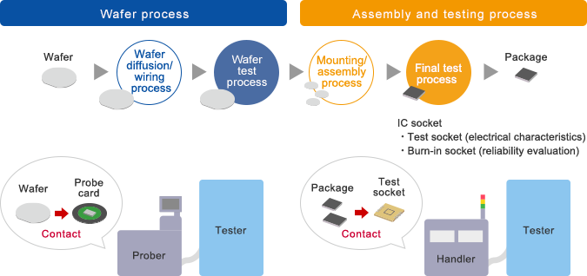
Recall: Wafer lifecycle in industry

Slide 5
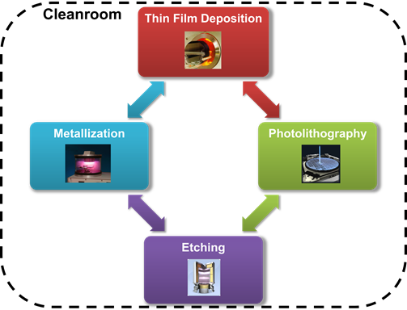
Closer look: Wafer Process
Today:
Litho
Etching
Next GBM:
Deposition
Metallization

Slide 6
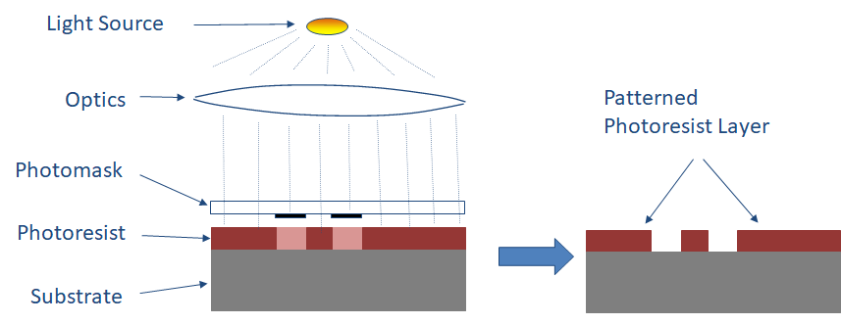
Basic Definitions: Patterning
Patterning- Process of transferring geometric patterns to the substrate using a photoresist ( a photosensitive layer) through PHOTOLITHOGRAPHY

Slide 7
Basic Definitions: Patterning
Patterning of photoresist to add or subtract materials from specific regions of a device.
Lithography is the most complicated, expensive, and critical step in modern processing
Most manufacturing process include 10-25 photolithography steps
Accounts for >1/3 of total cost

Slide 8
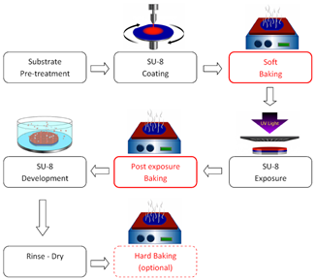
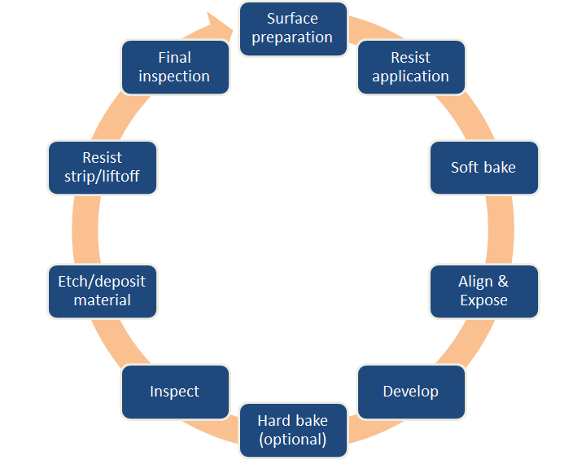
Wafer Process: Patterning

Slide 9
Step 1: Surface Preparation
Contaminants must be removed before photoresist coating
Examples:
Dust from scribing or cleaving
Clean away photoresist residue from previous photolithography step
Minimized by performing oxygen plasma ashing
Dust in the air (clean room habits and ppm)
Bacteria, lowered risk with good DI water system
Films from other sources- Solvent residue
H20 residue, silicone

Slide 10
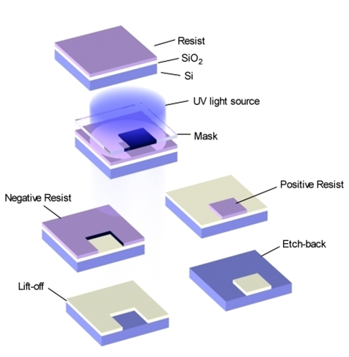
Step 2: Photoresist “PR” Application
What is Photoresist?
Used to pattern new features onto the wafer
PR is UV sensitive polymer
Negative PR hardens where it is exposed
Better adhesion
Better ion implant stability
Positive PR hardens where not exposed
More expensive
Higher resolution

Slide 11
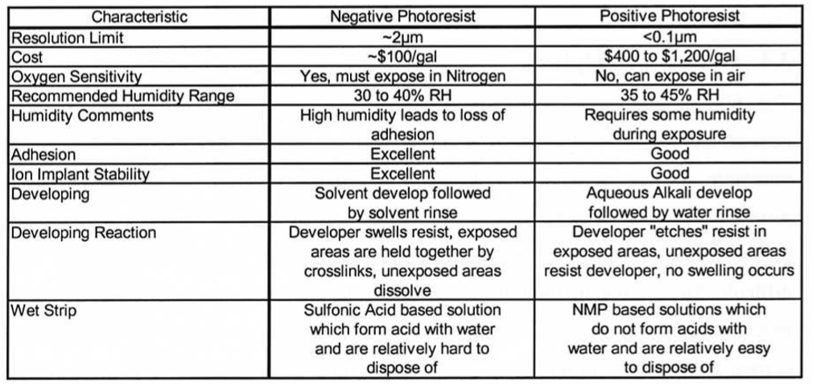
Step 2: Photoresist Reference Chart

Slide 12
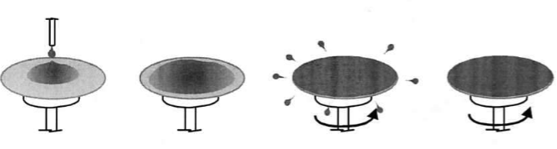
Step 2: Photoresist “PR”Application
Wafer is held on a spinner by a vacuum and resist in coated to uniform thickness by spin coating process.
Typically 3000-6000 rpm for 15-30 seconds
Summer lab uses ~3000 rpm for 1 minute
Thickness depends on:
1. Resist viscosity
2. Spinner rotational speed
Most are 1-2 um for commercial Si processes
w= angular velocity

Slide 13
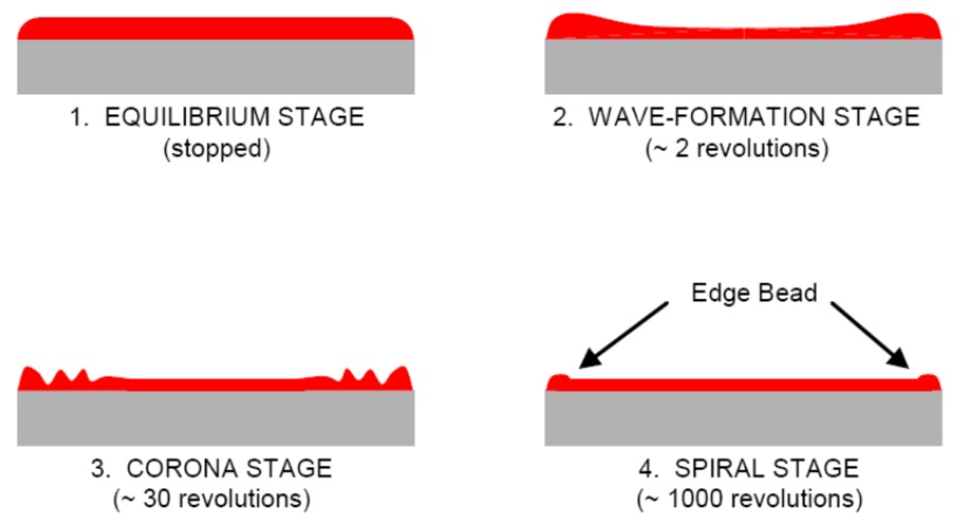
Step 2: Photoresist Application Stages
Notes:
Edge Bead:
-Residual ridge in resist at the edge of wafer
-20-30X the nominal thickness of the resist
-radius on wafer edge reduces the edge beat height
-non circular wafer increase edge bead height
-edge beat removers are solvents spun on after resist coating and will partially dissolve away the edge bead
Striations:
-~30 nm variations in resist thickness due to non uniform drying of solvent during spin coating
-~80-100 mm periodicity, radially out from center of wafer
Streaks:
-radial patterns caused by hard particles whose diameter are greater than resist thickness

Slide 14
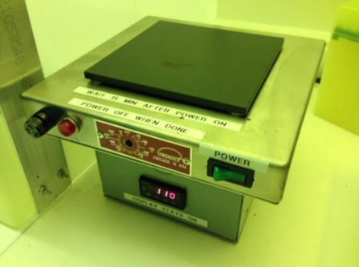
Step 3: Soft Baking
Purpose:
Used to evaporate the coating solvent and to densify the resist after spin coating
Optimizes light absorbance and adhesion of photoresist
Typical thermal cycles:
90-100 C for 20 min in convection oven
75-85C for 45 seconds on a hot plate
Faster, more controllable, traps less solvent
Problems:
Over Bake: polymerized (harden) less photosensitivity
Under Bake: Affects adhesion and exposure

Slide 15
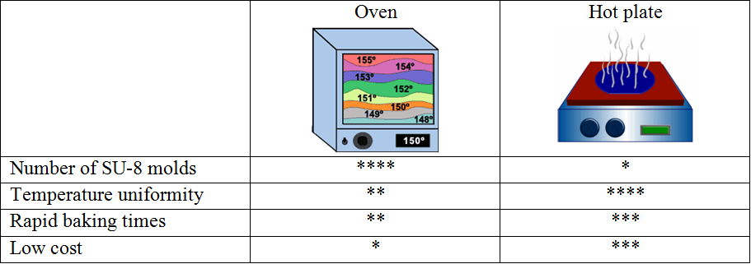
Step 3: Soft Baking Equipment

Slide 16
Step 4: Align & Expose

Slide 17
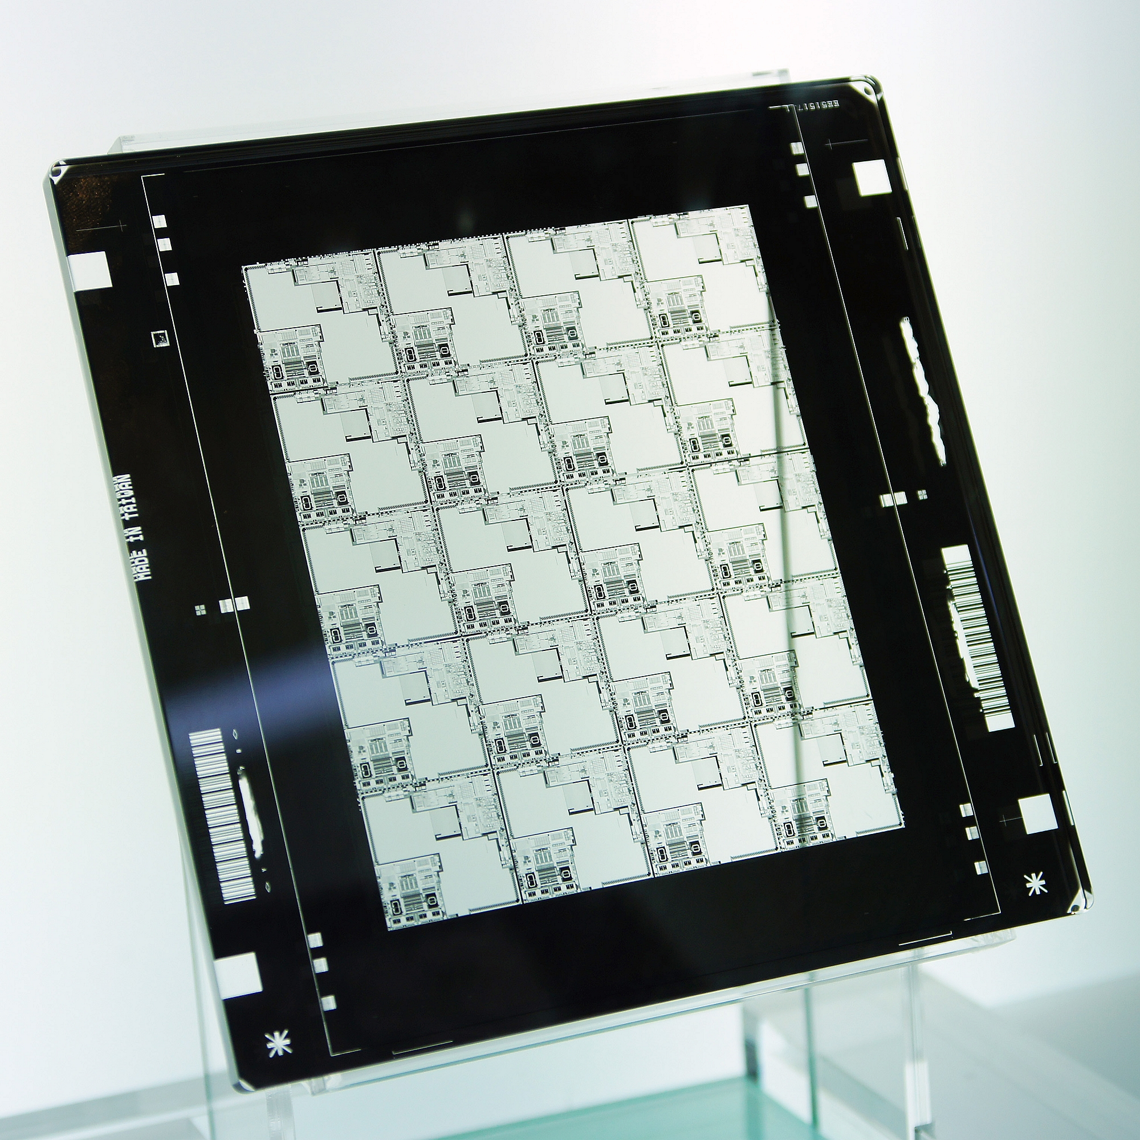
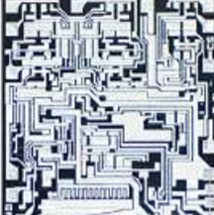
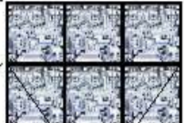
Step 4: Align & Expose
Photomask holds the pattern that will be exposed(with UV light) onto them photoresist layer of the wafer
Reticle containing a layer’s image of one or more die
Single Die Layout
Reticle exposed to UV light
Photomask containing reticle
Made of Chrome
Notes:
The chromium layer inside the photomask provides an opaque and mechanically strong layer to prevent light penetration through the mask.

Slide 18
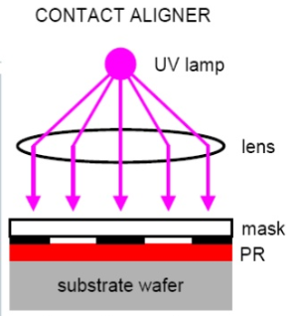
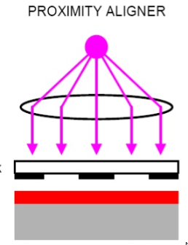
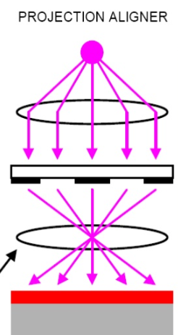
Step 4: Align and Expose
Good Resolution
Bad defect densities
Hard to print features below few mm in line width
High resolution
Low defect densities
50 wafers/hour
Notes:
-Projection systems give the ability to change the reproduction ratio (mask size to printed pattern size)
-Going to 10:1 reduction allows larger size patterns on the mask which is more robust to mask defects

Slide 19
Step 4: Align & Expose

Slide 20
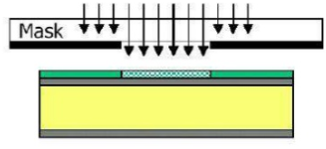
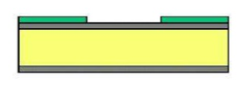
Step 5: Develop
Soluble areas of photoresist are dissolved by developer chemical
Now, visible patterns appear on wafer
Parameters to measure:
Line resolution
Uniformity
Particles and defects
Develop
Notes:
Goes through resist

Slide 21
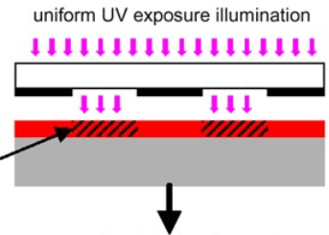
Step 5: Develop

Slide 22
Step 6: Hard Bake (Optional)
Hard baking in general is used to stabilize and harden the developed PR
It can be used as a post bake
Post bake removes any remaining traces of the coating solvent or developer
Higher temperature than soft bake (120-150 C degrees)
Needed for acid etching (BOE)
Not needed when soft PR is wanted (metal liftoff patterning)
The thermodynamic flow can alter the sidewall angles if needed (below)

Slide 23
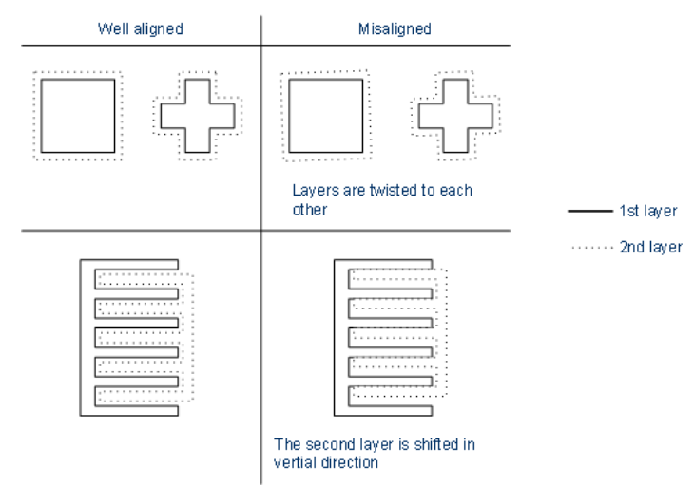
Step 7: Inspection
Sanity checks are important !!!
What are some things you would want to check for at this point?
Uniformity of layers
Agglomeration of resist
Structure size
Fix align marks

Slide 24
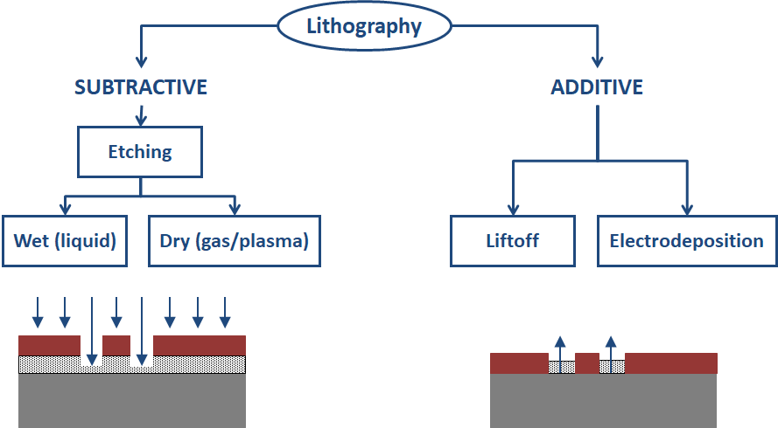
Step 8: Etch or Deposit material
Today
Next Lecture
Notes:
Goes through oxide

Slide 25
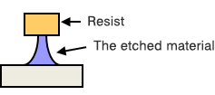
Step 8: Wet Etching (easier)
Oxidation-reduction equations often define wet etch processes
Silicon etch with HNO3 & HF
Most Wet Etch Processes are Isotropic
Certain mixtures can change rate depending on crystal orientation
Limited to feature sizes of ~3µm or greater

Slide 26
Step 8: Physical dry etching
Requires high energy kinetic energy (ion, electron, or photon) beams to etch off the substrate atoms.
High energy particles knock out the atoms from the substrate surface, the material evaporates after leaving the substrate.
No chemical reaction
Only the material that is unmasked will be removed
Notes:
Plasma - A partially ionized gas with equal numbers of positive and negative particles. Overall the plasma remains electrically neutral.
Ions typically don’t etch, radicals do. Ions affect the process by energetic (physical) bombarding of the surface, influencing the chemical processes of etching.
Radicals are responsible for the dry etching process. They are chemically active and react with the surfaces to produce volatile products
The plasma hits the silicon wafer with high energy to knock-off the Si atoms on the surface.
(a) The plasma atoms hitting the surface.
(b) The silicon atoms being evaporated off from the surface

Slide 27
Step 8: Chemical Dry Etching (“Vapor Phase”)
Does not use liquid chemicals or etchants.
Chemical reaction between etchant gases to attack the silicon surface.
Usually isotropic and exhibits high selectively.
Anisotropic dry etching has the ability to etch with finer resolution and higher aspect ratio than isotropic etching.
Undercutting can be avoided
Notes:
Process of a reactive ion interacting with the silicon surface.
(a) The interaction between the reactive ion and the silicon atom.
(b) A bond between the reactive ion and the silicon atom then chemically remove the silicon atoms from the surface.
Some of the ions that are used in chemical dry etching is tetrafluoromethane (CH4), sulfur hexafluoride (SF6), nitrogen trifluoride (NF3), chlorine gas (Cl2), or fluorine (F2).

Slide 28
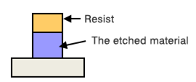
Step 8: Reactive Ion Etching “RIE”
Physical + chemical mechanisms to achieve high levels of resolution.
Most widely used processes in industry and research.
process is much faster.
The high energy collision from the ionization helps to dissociate the etchant molecules into more reactive species
Notes:
The RIE process. This process involves both physical and chemical reactions to etch off the silicon.
In the RIE-process, cations are produced from reactive gases which are accelerated with high energy to the substrate and chemically react with the silicon. The typical RIE gasses for Si are CF4, SF6 and BCl2 + Cl2

Slide 29
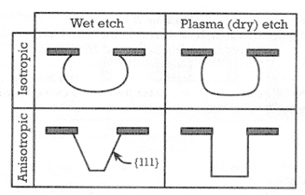
Step 8: Dry vs. Wet Etching

Slide 30
Step 8: Etching Terminology
Etch rate – Amount of material removed / time
Selectivity– Etch rate material 1 / etch rate material 2
Undercut (Bias)– Amount of lateral etching beneath the mask material
Isotropic – Etching is nearly identical in all directions
Anisotropic – Etching exhibits different values in different directions
QUIZ: How might Etch process know when to stop Etching?
Notes:
nswer: Many etch steps have “etch-stop” layer underneath that has very low etch rate to the etch chemistry introduced, but some etches are simply timed based on known etch rates

Slide 31
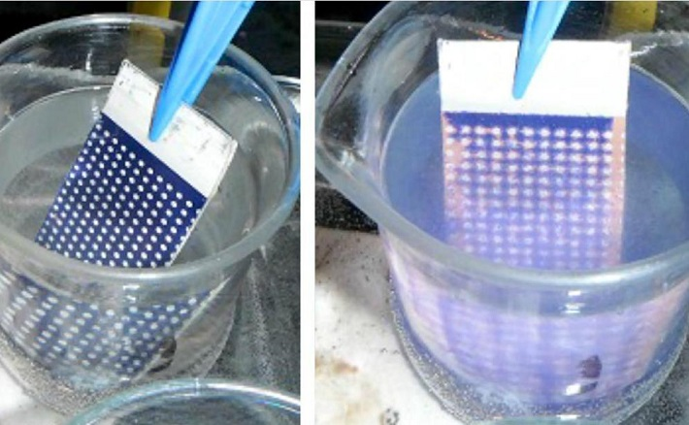
Step 9: Photoresist stripping
Goal: Remove PR and any residues
Positive PR:
Acetone
Trichlorethylene (TCE)
Phenol based strippers
Negative PR:
Methyl ethyl ketone (MEK)
Methyl isobutyl ketone (MIBK)
“Ashing”: Plasma etching with O2 as a method to remove organic polymer debris

Slide 32
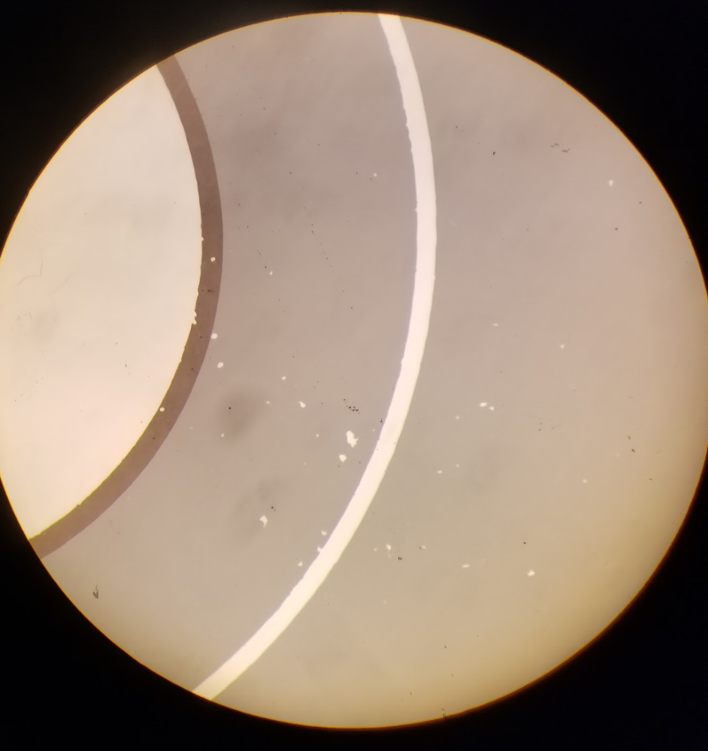
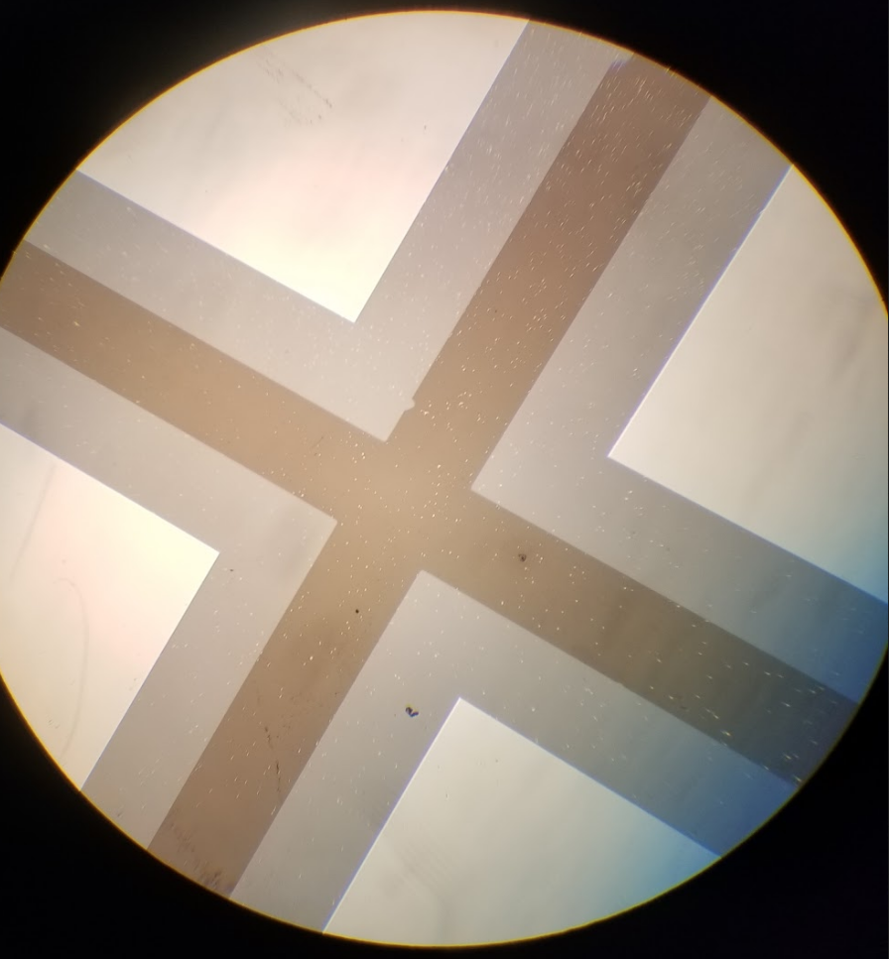
Step 10: FINAL INSPECTION
Make sure that Photoresist has been removed
Pattern on wafer matches the mask
Quality issues:
Defects
Particles
Stepheight
Critical dimensions

Slide 33
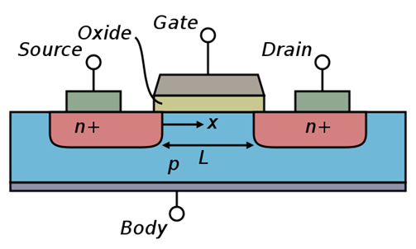
Improving device performance via patterning
The resolution of the optical system limits the density and size of the patterns printed on the wafer.
Decrease L through lithography scaling

Slide 34
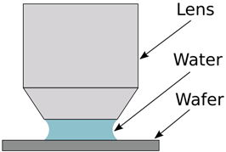
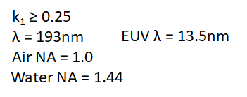
Improving device performance via patterning
Minimum feature size limited by wavelength of light used and refractive index of medium
Immersion lithography
Notes:
One method used extend the capability of ArF (193nm) photolithography systems to smaller technology nodes is to adopt water immersion based systems.
-Water sits between the optical lens and the wafer.
-This increases the index of refraction from n=1 (air) to n=1.44 (water), improving the resolution.

Slide 35
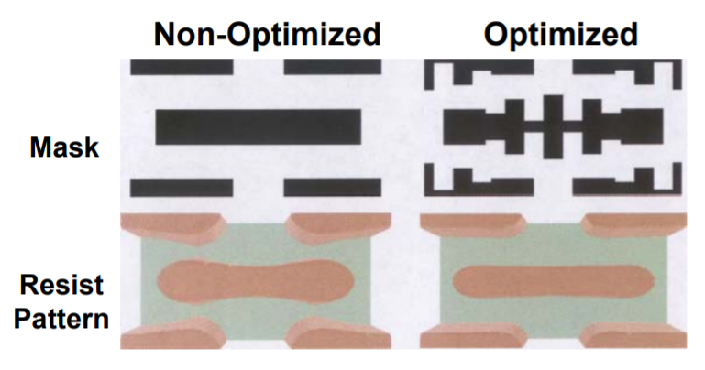
Improving device performance via patterning
Mask: Optical Proximity Correction or “OPC”
Sharp features are lost because diffraction attenuates higher spatial frequencies (mask behaving as low-pass optical filter)
Compensate for diffraction effects when feature sizes << λ by managing sub- λ constructive & destructive interference
Exaggerate edges and corners to “equalize” cutoff spatial frequency of mask
Notes:
One method used extend the capability of ArF (193nm) photolithography systems to smaller technology nodes is to adopt water immersion based systems.
-Water sits between the optical lens and the wafer.
-This increases the index of refraction from n=1 (air) to n=1.44 (water), improving the resolution.

Slide 36
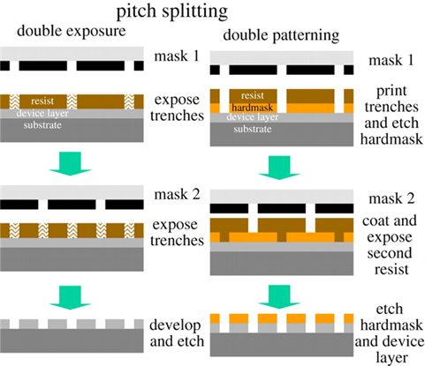
Improving device performance via patterning
Pitch splitting is the process where the design layout for a given layer is split across multiple photomasks and each mask is exposed separately to pattern the layer.
At 7nm, as many as four separate exposures are required for critical layers.
This significantly increases the manufacturing cost.
Notes:
193nm immersion lithography has been extended to the 7 nm technology node thanks to the extensive use of pitch splitting.

Slide 37
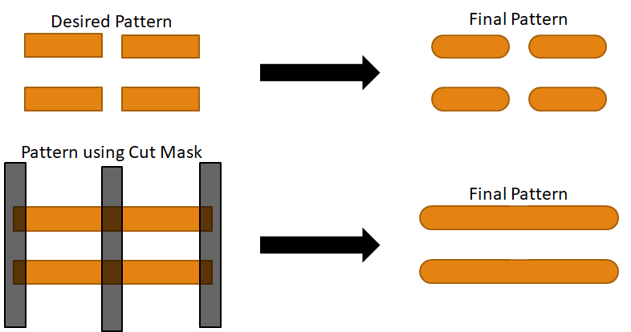
Improving device performance via patterning
Multiple patterning with Cut Masks – helps with combating light diffraction effects
Performed when single immersion patterning is not enough, and EUV is not practical
Notes:
Extra mask to cut or “slice through” patterns
• Significantly reduces end-to-end spacing for are
alignment challenge between line and cut masks

Slide 38
Improving device performance via patterning
Past 7nm: EUV- EXTREME UV LITHO
Here's a really good video making it very easy to understand
https://www.youtube.com/watch?v=f0gMdGrVteI&feature=youtu.be

Slide 39
Thanks!
Questions?
Tune in next GBM when we go over Deposition & Metallization
GBM

