Slide 1
SCRO GBM #9
Lecture 6
Special thanks to our sponsor:

Slide 2
Deposition Techniques and Metallization
SCRO Spring 2020 GBM 10

Slide 3
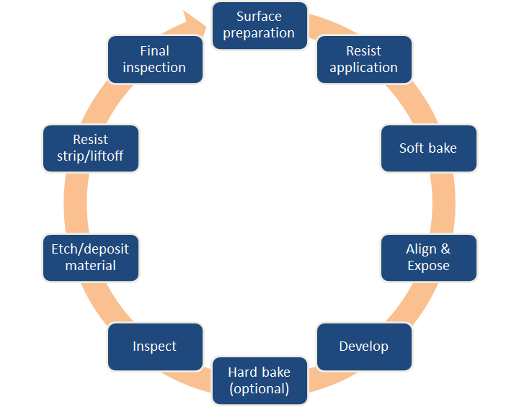
Recall steps from last lecture on Patterning
Deposition is an Additive process
Etching is a Subtractive process

Slide 4
Deposition Techniques
Physical Vapor Deposition
Sputtering
Chemical Vapor Deposition
Epitaxy
Metallization
Low Pressure/Vacuum Process
Atmospheric Pressure Process

Slide 5
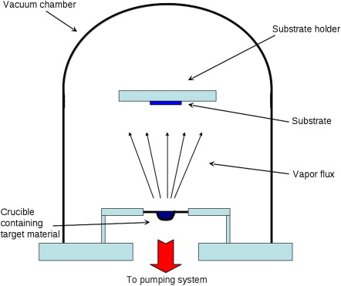
Physical Vapor Deposition(PVD)
Oldest method for Metal Deposition
Will be used in SCRO Summer Lab
Localized source evaporation
Aluminium and Gold Deposition
Poor side-step coverage
Types(based on source heating):
Filament Evaporation
E-Beam Evaporation
Flash Evaporation

Slide 6
Step Coverage

Slide 7
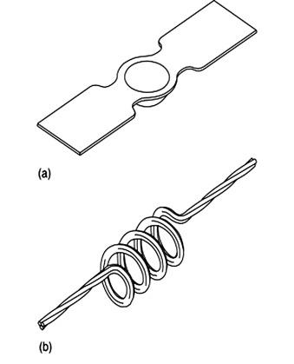
PVD: Filament Evaporation
Source material is kept in a refractory boat(a)
Boat is heated till material is melted and evaporated
Source material is attached to resistive filament(b)
Current is passed through filament till material is melted and evaporated.
Pros
Easy to set up
Cons
Filament Contamination
Unemployable for Composite/alloy films
Unfeasible for thick films

Slide 8
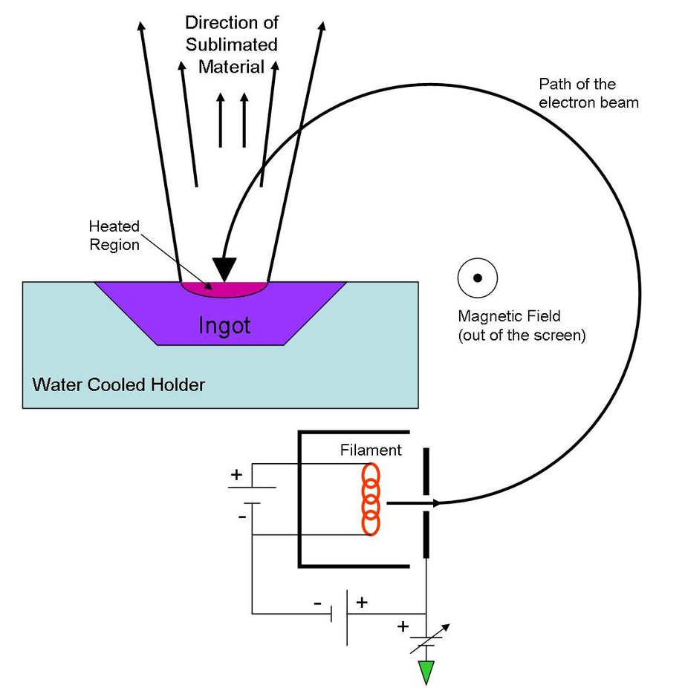
PVD: E-Beam
Localized source evaporation by focused high energy e-beam
Water cooled source
Current and Voltage of E-beam regulate deposition rate
Pros:
Alloy deposition possible using dual E-beam
Accurate deposition rate measurement (up to 1 A°/sec)
Cons:
Radiation damage from X-ray of high energy beam

Slide 9
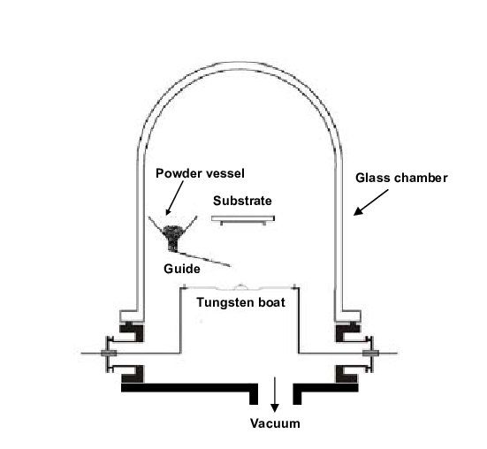
PVD: Flash Evaporation
Localized evaporation of source powder or source wire
High temperature ceramic heating
Pros:
Thick film deposition feasible
No radiation damage like E-beam

Slide 10
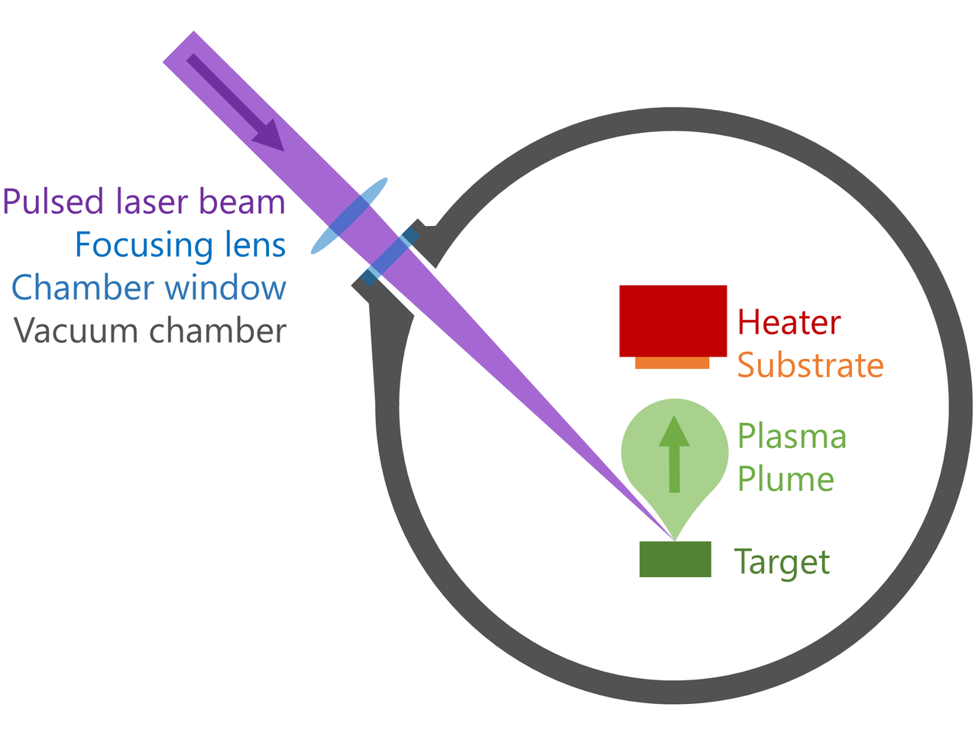
PVD: Pulsed Laser Deposition
Localized source evaporation by high energy pulsed laser
Complex mechanism
Laser absorption
Source ablation
Plasma formation
Deposition
Nucleation and growth

Slide 11
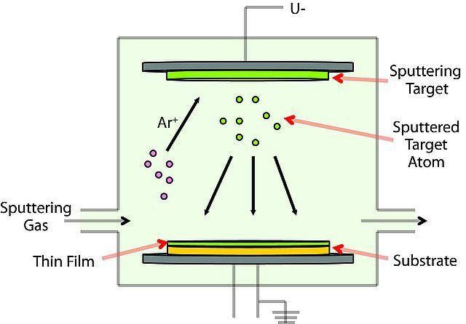
Sputtering

Slide 12
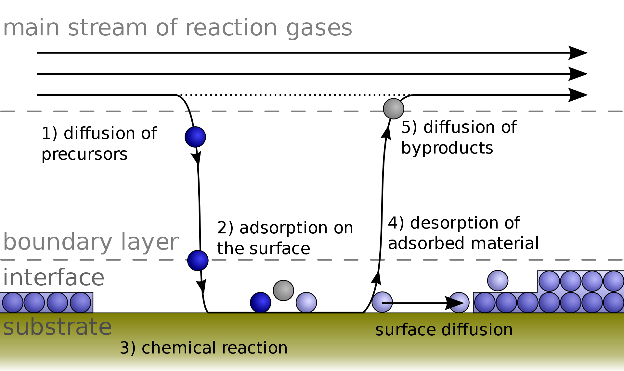
Chemical Vapor Deposition(CVD)
Chemical/ thermal decomposition of gaseous compounds
Types:
APCVD /CVD(Atm Pressure)
LPCVD(Below Atm Pressure)
UHVCVD(< 10⁻⁶Pa)
PECVD(Plasma Enhanced Reactions)
MOCVD(Metal Organic Precursors)
ALD(Monolayer Deposition)
Pros:
Faster, cheaper, Better Step Coverage (than PVD)
Applications:
Dielectrics: SiO₂, Si₃N₄
Metals: W, Ta, Ti, Nb, Mo, Al, Cu
Poly-Si, Graphene

Slide 13
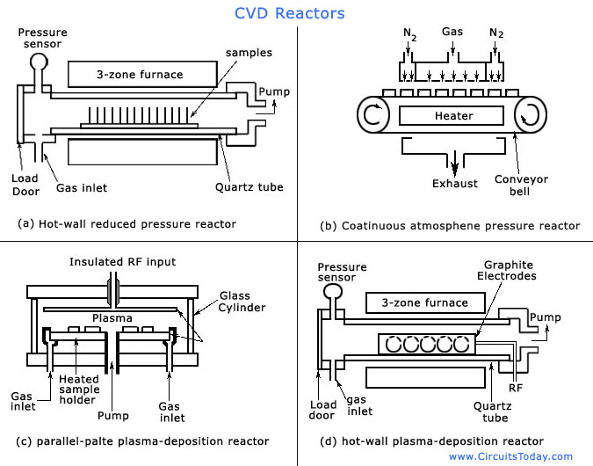
CVD: Reactors

Slide 14
CVD: Reactors

Slide 15
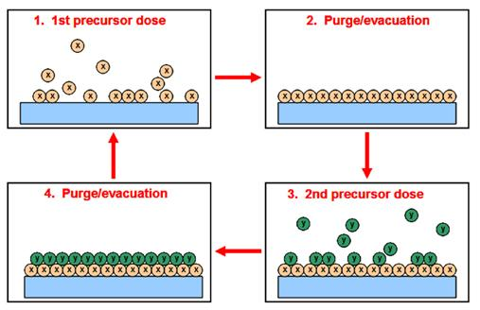
CVD: ALD
Alternating Precursor Exposure
Self limiting reaction
Pros:
Low Temperature Operation
Wide Range of Precursors
Applications:
Oxides, Metals, Sulphides, Chlorides

Slide 16
CVD
Poly Si : Thermal decomposition of Silane at 600 °C
SiH₄ + O₂ Si + H₂ 600-650 °C
Doping during deposition is possible by adding impurities source gases like PH₃, AsH₃, B₂H₆
SiO₂: Multiple reactions possible
SiH₄ + O₂ SiO₂ + H₂ 400-450 °C
SiCl₂H₂ + N₂O SiO₂ + 2N₂ + 2HCl 400-450 °C
Si(OC₂H₅)₄ SiO₂ + byproducts 650-750 °C
Note: For deposition over low melting point metals like Al, temperature must not exceed alloy eutectic temperature
Better choice of reactions
Better uniformity
Better step coverage

Slide 17
CVD
Si₃N₄:
3SiH₄ + 4NH₃ Si₃N₄ + 12H₂ 600-650 °C
SiCl₂H₂ + 4NH₃ Si₃N₄ + 6H₂ + 6HCl 600-650 °C
2SiH₄ + N₂ Si₃N₄ + SiNH +3H₂
SiH₄ + NH₃ Si₃N₄ + SiNH +3H₂
Applications:
Oxidation mask in recessed oxide process
Final passivation layer
APCVD
LPCVD
PECVD
Non-stoichiometric composition
200-350 °C
Property | Comparison
Resistivity | ϱ(LPCVD) > ϱ(PECVD)
Tensile Stresses in films | σ(LPCVD) > σ(PECVD)
Dielectric Strength | K(LPCVD) > K(PECVD)
Hydrogen Content of films | H₂(LPCVD) < H₂(PECVD)

Slide 18
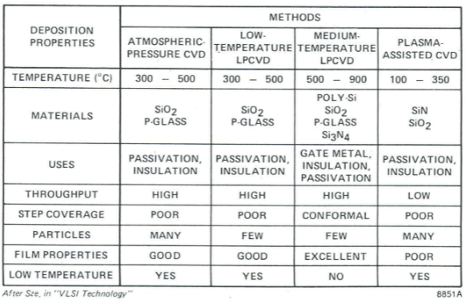
CVD : Some more comparison

Slide 19
Epitaxy
Crystalline growth of material using substrate as a seed crystal
Types:
Vapor phase Epitaxy
Source delivery via gas phase
Liquid phase Epitaxy
Solution crystallizes into solid layer
Molecular beam Epitaxy
Material transport by molecular beam
Film(Green)
B
Substrate(Blue)
A
B
Film(Green)
A
B
Substrate(Blue)
A

Slide 20
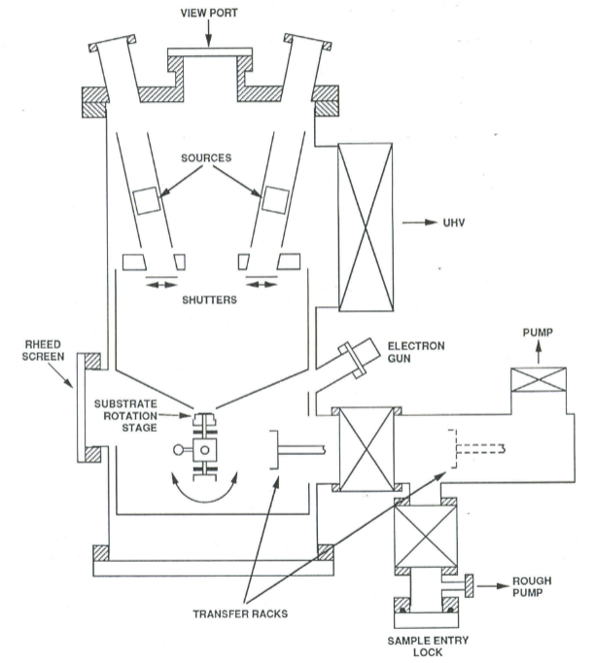
MBE
Most widely used in Semiconductor manufacturing
Material transport by molecular beam
Purer films due to absence of carrier gases
In-situ thickness measurement using RHEED gun

Slide 21
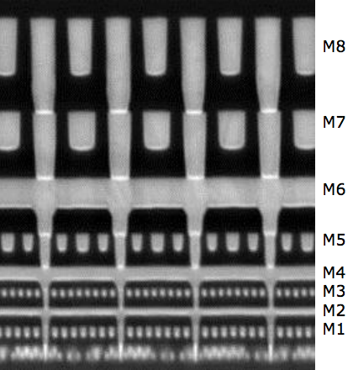
Interconnects and Contacts
Key requirements:
Low Contact Resistance
Low Sheet Resistance
Low voltage drop
Low Propagation delay
Common Metals:
Gold, Copper, Aluminium, Alloys
Problems:
Electromigration
Diffusion (Al, Au)
Deep Level Contamination (Au)
Spiking(Al)

Slide 22
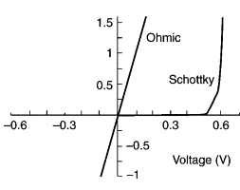
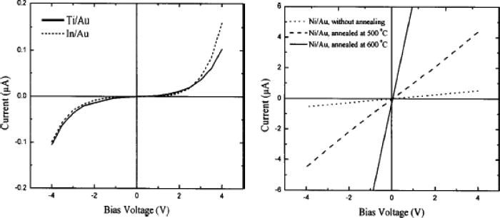
Contact Types(I-V based)
Ohmic linear
Schottky
Ohmic non-linear

Slide 23
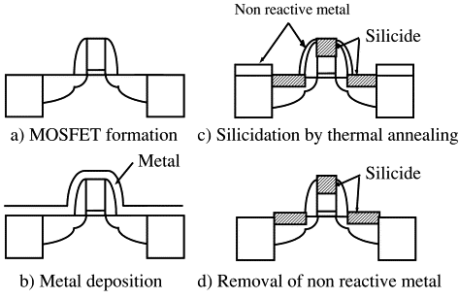
Contacts
Self Aligned Contacts
Formation of Self aligned Metal Silicide

Slide 24
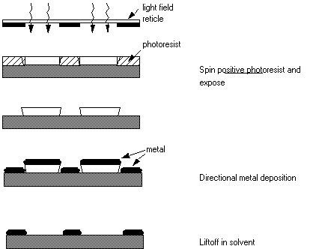
Lift Off

Slide 25
References
https://www.slideserve.com/glynn/epitaxial-deposition
https://danluu.com/cpu-backdoors/
http://inst.cs.berkeley.edu/~ee143/fa08/lectures/Section%208%20-%20Metallization.pdf
https://avem.org/press-releases/featured-articles/item/100-challenges-for-non-ideal-atomic-layer-deposition-processes-and-systems
http://www.phys.ufl.edu/~nanoscale/reports/year1/liftoff.html
https://www.sciencedirect.com/science/article/abs/pii/S0167931701006840
https://ufl.instructure.com/courses/389113/files?preview=47251034
Richard C Jaeger, “Introduction to Microelectronic Fabrication”

Slide 26
Thanks!
Questions?
Next GBM will go over Etest and Reliabilty
GBM

