Slide 1
SCRO GBM # 6
Lecture 4: Memory & SOC
By Sharanya Srinivasan
Special thanks to our sponsor:

Slide 2
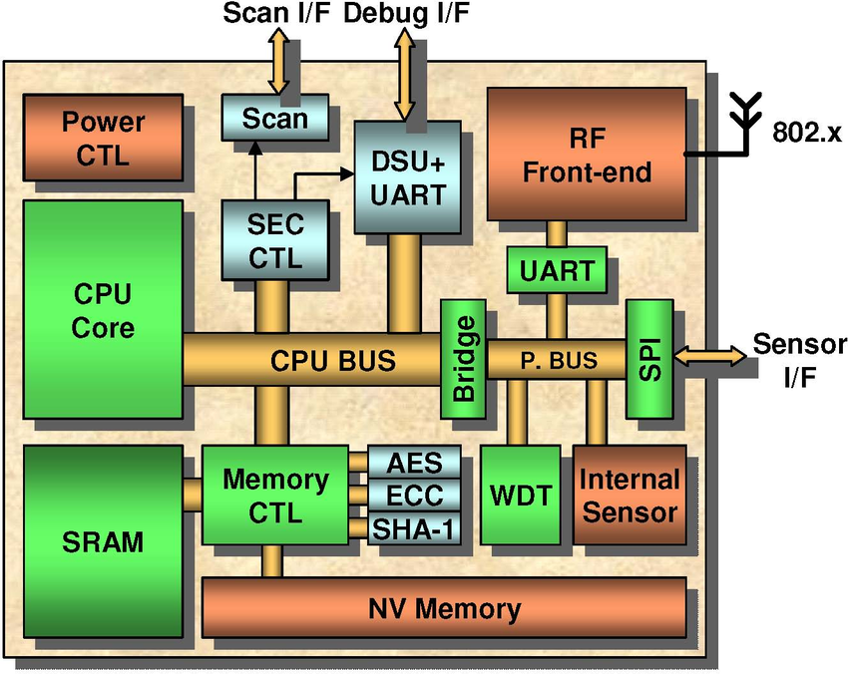
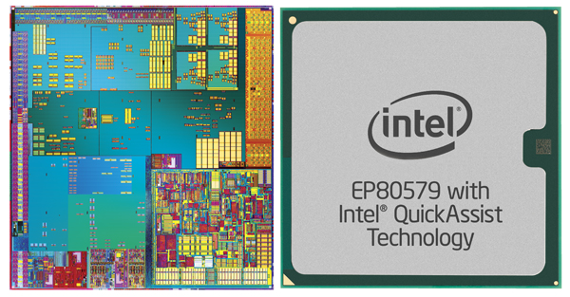
What is an SOC and why is it important?
SOC stands for System-On-Chip. It is an Integrated circuit that connects all the components in an electronic.
Memory stores and retrieves data when needed by the SOC.
SOC logic and memory uses transistors.
INTEL SOC
SOC contains CPU and Memory (red)

Slide 3
Do you all recall logic gates??? AND,OR, NOR, NAND, NOT truth tables??
SOC logic and memory concepts can be laid out in terms of circuit. As in, you express a ‘mother board’ in the CPU in terms of circuits in order to layout transistors.
Electrical circuits are expressed in terms of logic gates for the ease of communication.
These logic gates are further expressed in terms of lumped discrete circuits.
These elements are fabricated (transistors, capacitors, diodes etc.)
Notes:
Each logic gate is made up of certain number of discrete electronic elements. Combination of logic gates when connected forms an electrical circuit. A lot of intricated electrical circuits makes an Integrated Circuit (IC).
Add pic??

Slide 4
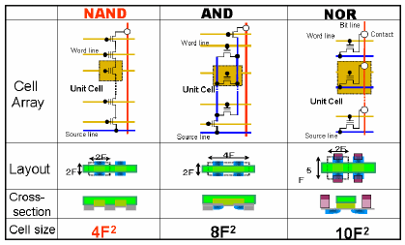
Connecting the dots
[3]

Slide 5
How does a memory store data?
Computer data can be expressed in bits(binary digits). Binary digits are either 0 or 1.
The electronic devices that makeup the memory component would convert the 0s and 1s to voltage (0V and 5V).
These memory components are electronic hardware that will store the bits as voltages.

Slide 6
How does a memory store data?
Every number in a computer can be represented in binary (0/1)
For a simple example: The binary 1001 converts to decimal 9.
To store this in memory, the 1’s get stored as Vcc (5V) and the 0’s as Gnd(0V)
Exponential | 2³ | 2² | 2¹ | 2⁰
Solved Exp | 8 | 4 | 2 | 1
Binary Number | 1 | 0 | 0 | 1
Multiply Exp x Bin | 8 + | 0 + | 0 + | 1 = | 9

Slide 7
2 Main Memory Types[4]
Volatile Memory | Non-volatile Memory
1. Stores information for immediate use | 1. Stores the information for later use
2. Data is stored temporarily. (Lost when power is lost) | 2. Data is stored permanently (Persists even when power is lost)
4. FAST | 4. Slower
5. More Expensive per GB Ex. 16GB RAM $50 | 5. Cheaper per GB Ex. 500GB SSD $50
7. Stores data to be computed (Ties to performance) | 6. System Storage (Stores your PPTs)
8. Examples: RAM (Random Access Memory), Cache, SRAM, DRAM. | 8. Examples: ROM(Read Only Memory), SSD, SD card, pen drive etc.

Slide 8
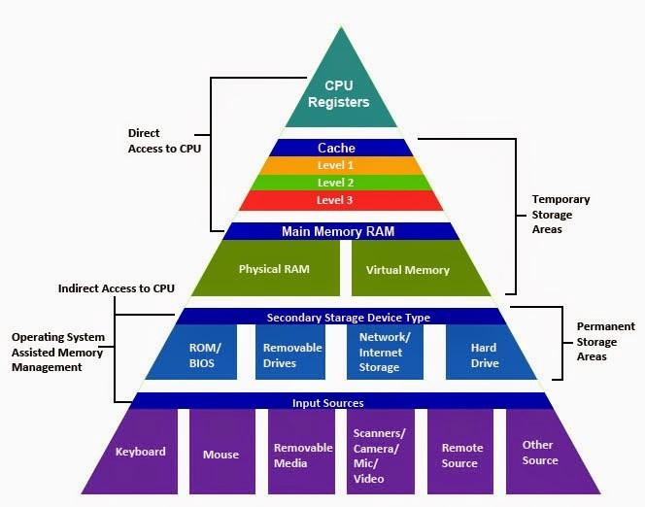
Memory Block Diagram
Within volatile and non volatile memory there are sub memory types
SRAM
Volatile Memory
DRAM
Non-volatile Memory
[7]

Slide 9
Volatile Memory: Differences between SRAM and DRAM[8,9]:
SRAM (Static Random Access Memory) | DRAM (Dynamic Random Access Memory)
1. 6 transistors to store each bit. | 1. 1 transistor and one capacitor to store each bit.
2. Stores data only when power is supplied. | 2. Stores data for only few milliseconds even when power is supplied.
3. Can access data faster. | 3. Data access is slower.
4. Consumes more power. | 4. Consumes less power.
5. Offers less memory per chip. | 5. Offers more memory per chip.
6. Cost per bit is high. | 6. Cost per bit is low.
7. Does not require to refresh memory cell. | 7. Requires to refresh the memory cell after reading of capacitor.
8. SRAMs are mainly used for cache memory. | 8. DRAMs are mainly used for main memory (RAM).

Slide 10
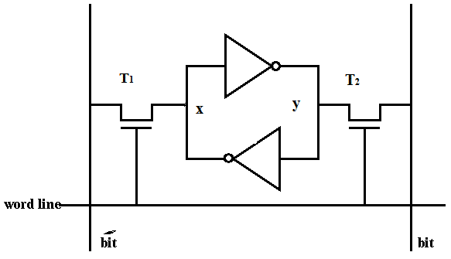
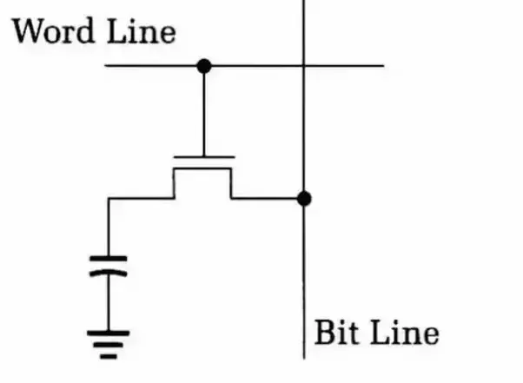
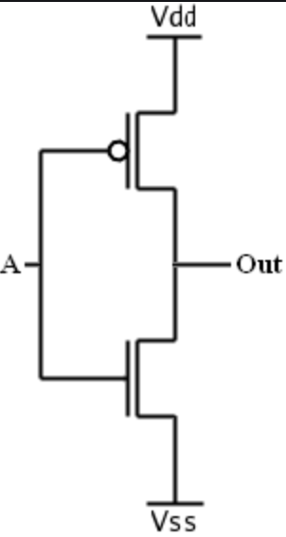
SRAM Schematic:
DRAM Schematic:
NOT
The word line is connected to the gate of the transistor
The bit line is connected to the drain of the transistor

Slide 11
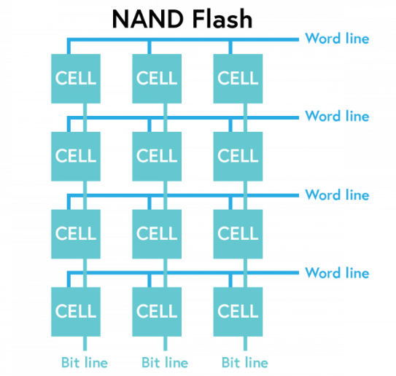
Unit cell of memory
Each unit cell of the logic gate stores for 1 bit (except for flash memory: 1-4 bits per unit cell).
A Unit cell of SRAM consists of 6 transistors. In a die, you can have many unit cells billions transistors.
The unit cells are connected in a matrix with word lines and bit lines to drive select the correct cell
Every mobile phone has DRAM, SOC and Flash memory.

Slide 12
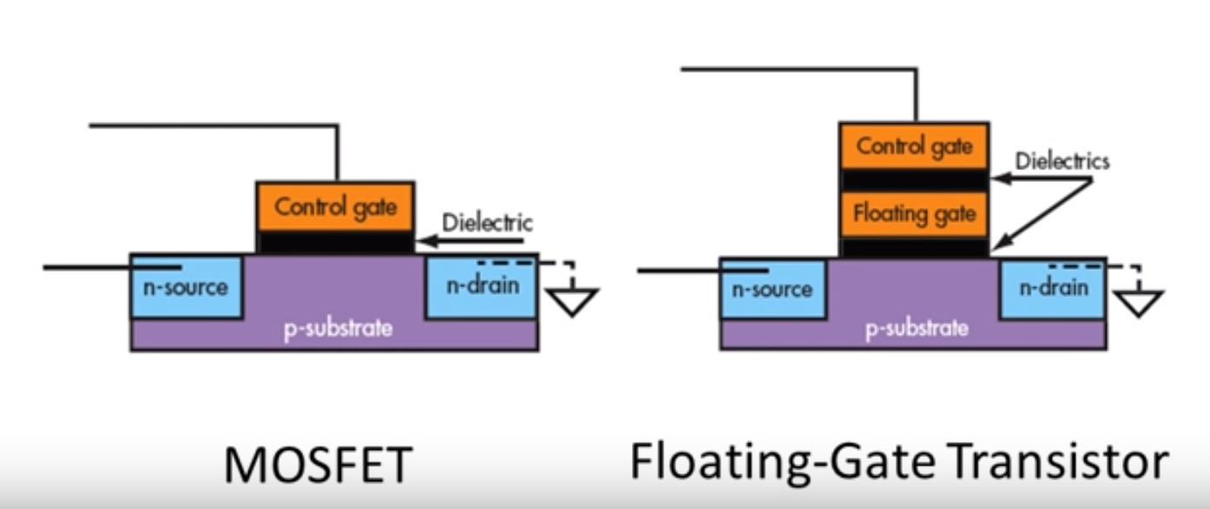
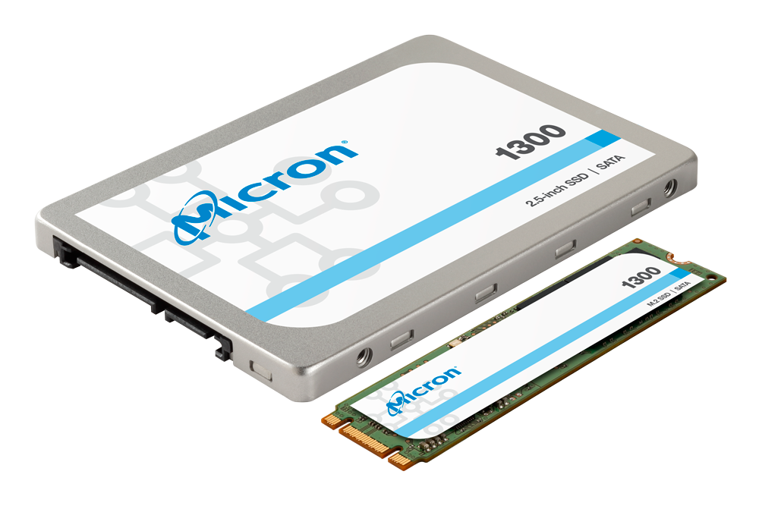
Nonvolatile: NAND Flash
A NAND flash memory is a type of non-volatile memory that is mainly found in computers, memory cards, mobile phones. NAND Flash cells contains floating gate.
A NAND gate with two inputs has 4 transistors. Flash memory is created using NAND or NOR gate.
[3]

Slide 13
Comparison of Logic Gates
Area of a transistors is always represented as feature size. Feature size is nothing but gate length.
As gate length(=channel length) decreases, electrons moves over a smaller distance from source to drain, as a result, the device works faster.
F = Feature size
[3]

Slide 14
Comparison between SRAM,DRAM and NAND
Attributes | SRAM | DRAM | NAND Flash
1. Volatile/Non-volatile | Volatile | Volatile | Non-volatile
2. Speed | Fastest (0.1ns) | Fast (10ns) | Slow (100,000 ns)
3. Cost per bit | High | Low | Lowest
4. Applications | Cache memory | Main memory (RAM) | SSD, Flash Drive, SD Card.
5. No of devices per unit cell | 6 transistors | 1 transistor, 1 capacitor | 4 transistor per three bits
6. Area of the die/chip | ~ (60 to 80) f² | ~ 6 f² | ~ 2 f²
Notes:
It is important to not that while nand flash is slow, it is still very fast compared to hard drives

Slide 15
Example Problem
iPhone X (Apple A11 Bionic chip) has 256 GB Flash (not on SOC), 3 GB DRAM (not on SOC), and the SOC has 4.3 billion transistors. [6]
How many transistors should we fabricate if we want a phone of this specifications??
Flash memory: 3 bits per transistor.
Dram has: 1 bit per transistor.
1 Byte= 8 bits 1GB = 10⁹ Bytes
Soln:
Flash Memory: 256 (GB) × 10⁹ × 8 = 2048 (Billion bits)
2048 (Billion bits) / 3 (bits/transistor) = 682.7 (Billion transistors)
DRAM: 3 (GB) × 109 × 8 = 24 (Billion bits)
24 (Billion bits) / 1(bits/transistor) = 24 (Billion transistors)
SOC: 4.3 (Billion transistors)
TOTAL: 711(Billion transistors)

Slide 16
References
[1] https://www.trustedreviews.com/news/
[2] https://www.researchgate.net/figure/General-architecture-of-embedded-core-based-system-on-chip SoC_fig1_257943815
[3] https://www.eetimes.com/document.asp?doc_id=1272118
[4] https://www.geeksforgeeks.org/difference-between-volatile-memory-and-non-volatile-memory/
[5] https://simple.wikipedia.org/wiki/Computer_memory
[6] https://en.wikipedia.org/wiki/Apple_A11
[7] https://medium.com/@barbaradecares/the-memory-hierarchy-f9c3016d7cba
[8] http://gcloudspace.blogspot.com/2013/11/difference-between-sram-and-dram.html
[9] https://www.quora.com/What-is-the-difference-between-SRAM-and-DRAM
[10] https://www.researchgate.net/figure/Schematic-diagram-of-a-standard-6T-SRAM-bitcell_fig1_261288338
[11] https://electronics.stackexchange.com/questions/144986/schematic-for-run-of-the-mill-sram

Slide 17
Thank you for coming ☺
Any Questions??

